Slide 1
Interpretable Deep Learning

Slide 2
Interpretable vs Explainable
After: explainable AI (XAI)
Before: interpretable AI

Slide 3
After: Explainable AI
Feature importance, partial dependency plots
Shapley values
Saliency maps, Integrated gradients, layerwise relevance propagation, etc.
Global surrogate models
Local surrogate models (e.g., LIME)
Counterfactuals
Interpretable Machine Learning, C. Molnar (2020)

Slide 4
After: Explainable AI
Feature importance, partial dependency plots
Shapley values
Saliency maps, Integrated gradients, layerwise relevance propagation, etc.
Global surrogate models
Local surrogate models (e.g., LIME)
Counterfactuals
Interpretable Machine Learning, C. Molnar (2020)

Slide 5
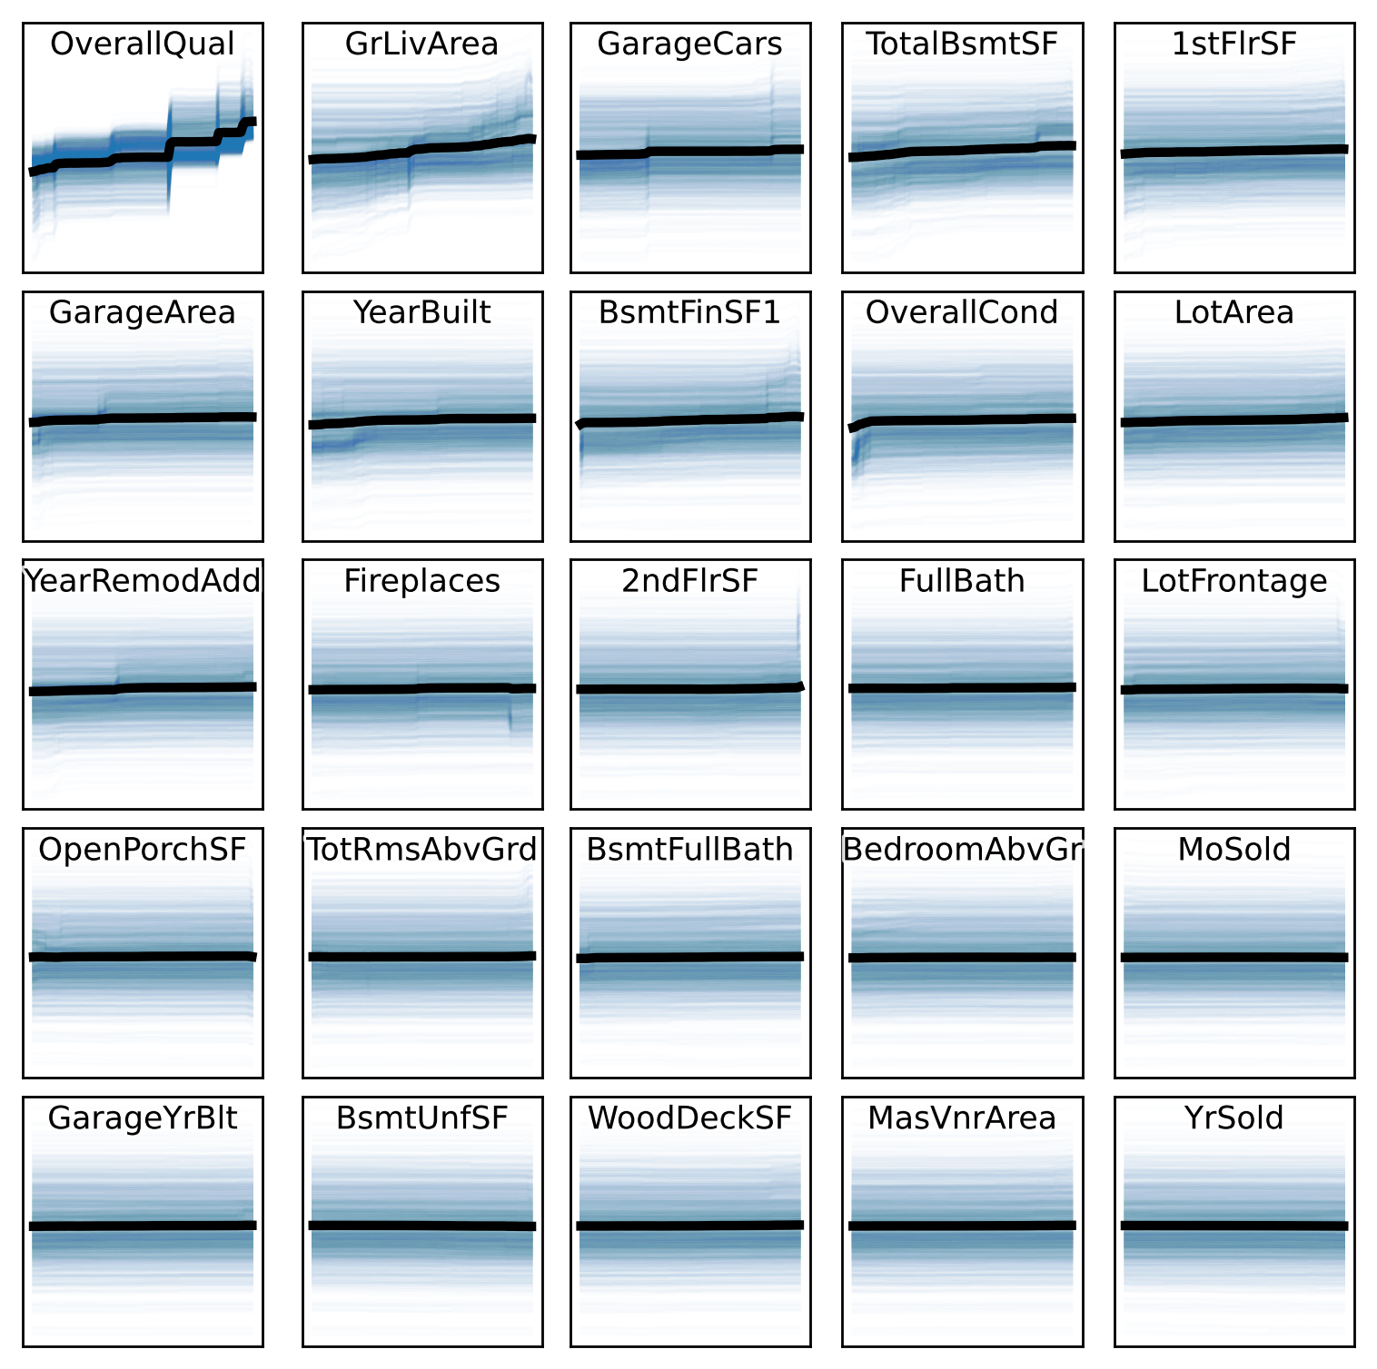
Partial Dependency Plot
For each observation i, how does the output change if we change variable j (while keeping the others constant)?
Average of those curves
Interpretable Machine Learning, C. Molnar (2020)

Slide 6
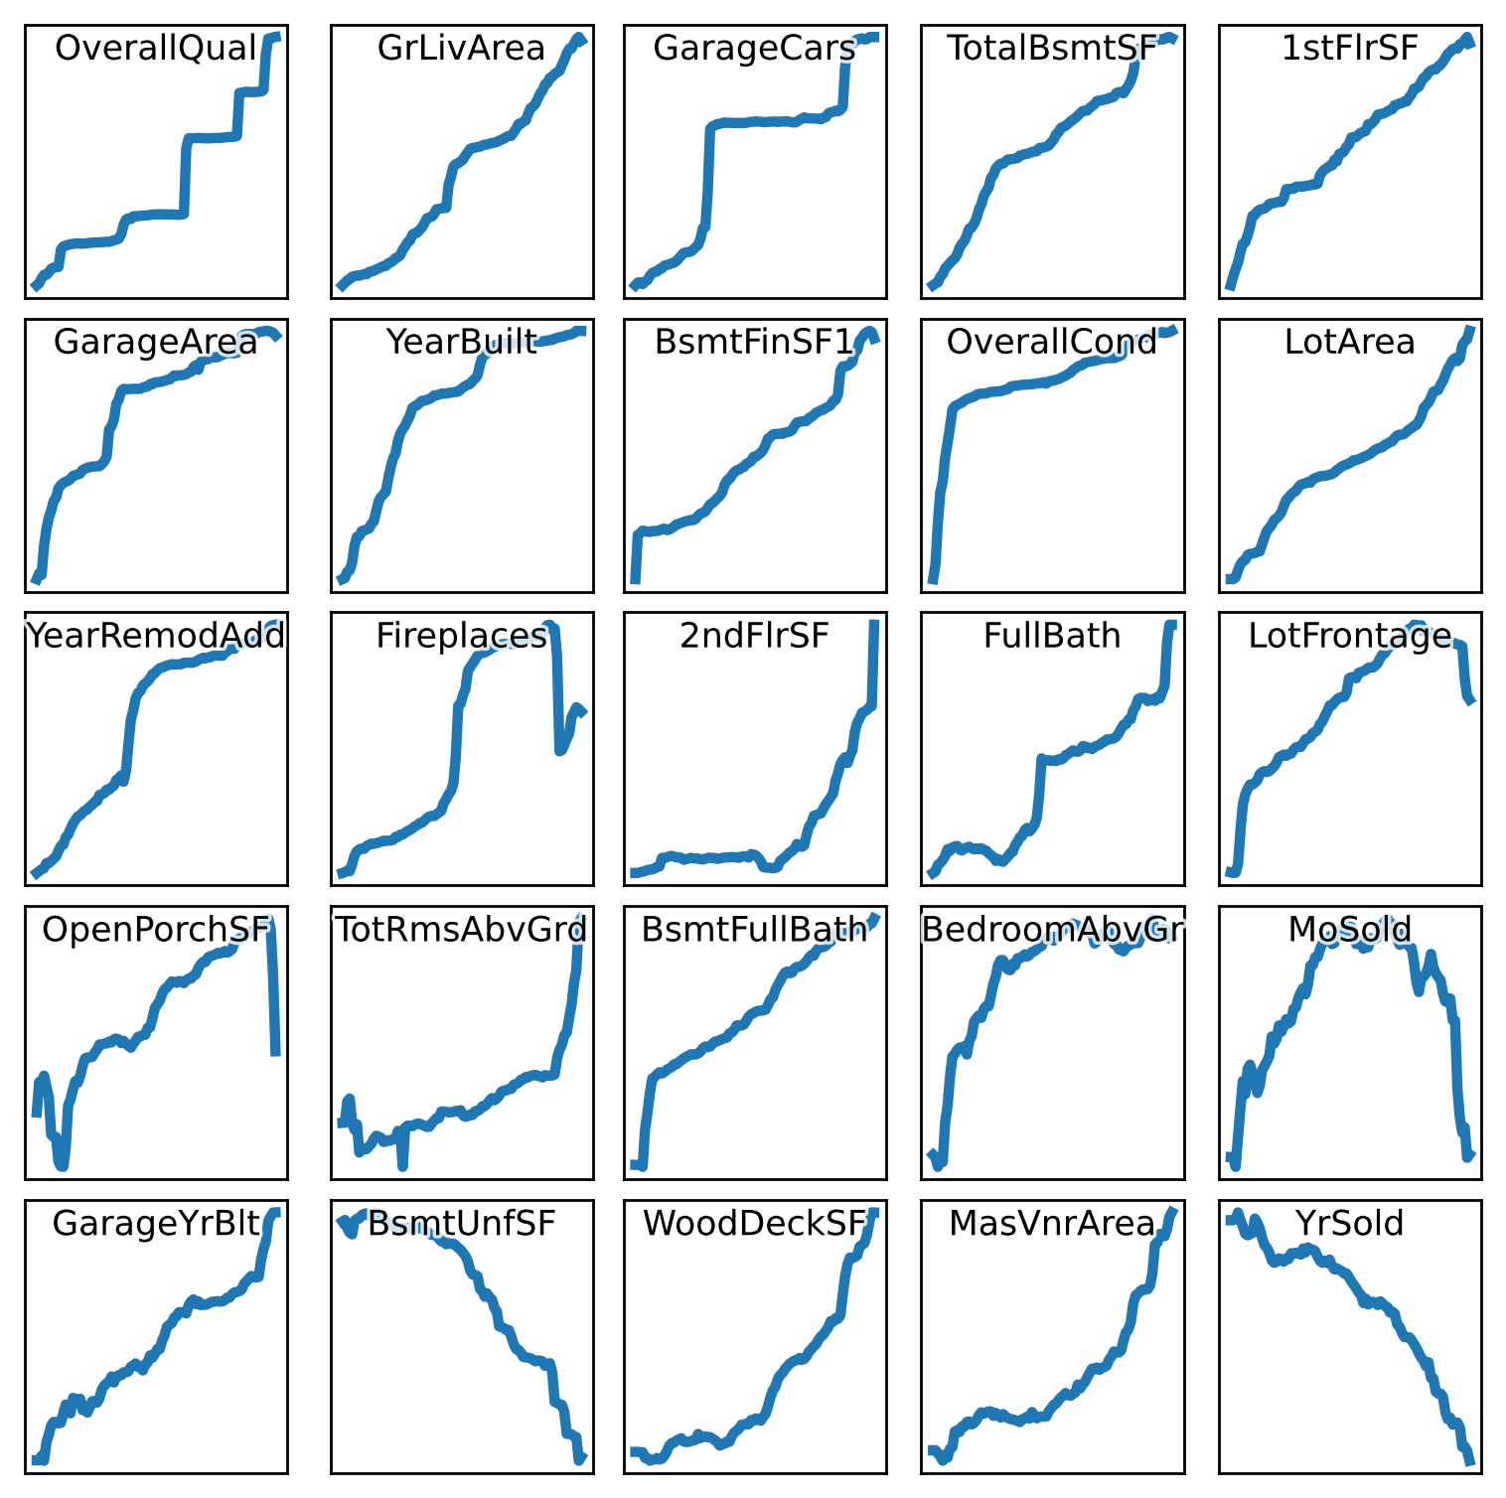
Partial Dependency Plot
For each observation i, how does the output change if we change variable j (while keeping the others constant)?
Average of those curves
Interpretable Machine Learning, C. Molnar (2020)

Slide 7
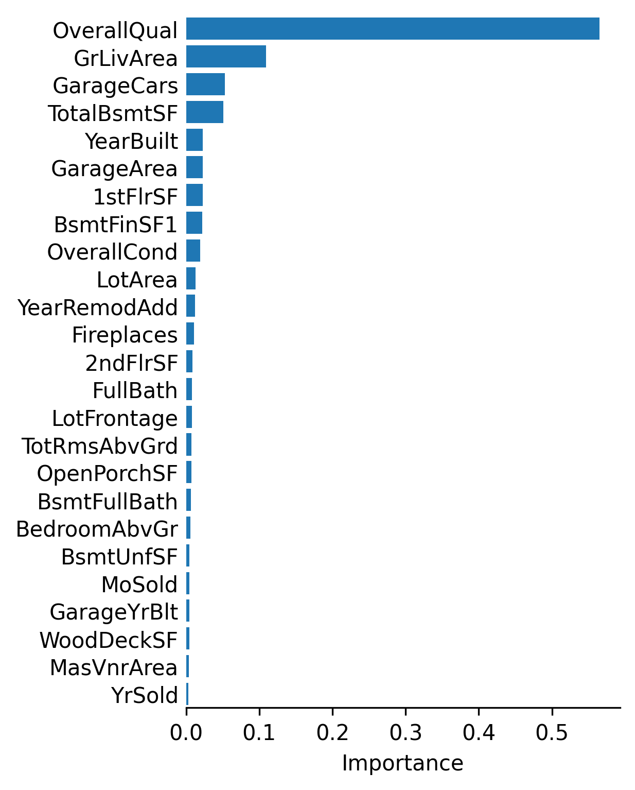
Feature Importance
How does the accuracy of the model decrease if we remove (or shuffle) one input variable?

Slide 8
Local Surrogate Models
Simpler, interpretable model (e.g., linear regression or shallow regression tree), trained to reproduce the output of a more complicated model, but only in the vicinity of a given observation.
“For observations similar to this one, the model works as follows: ...”
Why should I trust you? Explaining the predictions of any classifier, M.T. Ribeiro et al. (2016)

Slide 9
What makes a model interpretable?
No rigorous definition:
Sparsity
Monotonicity
Modularity
Linearity
Designing inherently interpretable machine learning models, A. Sudjianto and A. Zhang (2021)

Slide 10
Before: Interpretable AI
Linear Models
Lasso: fused, group, graph sparsity
Sign constraints
SLIM
ML models
Rule lists, decision trees
Gradient boosting
GAM, GA²M, AIM
Deep learning models
Monotonicity: activation functions, gradient penalty
Sparsity
Varying coefficient models
Mixture of experts

Slide 11
Linear Models

Slide 12
Linear models
Lasso, elastic net
Fused lasso, group lasso, graph sparsity
Sign constraints
Supersparse integer linear model

Slide 13
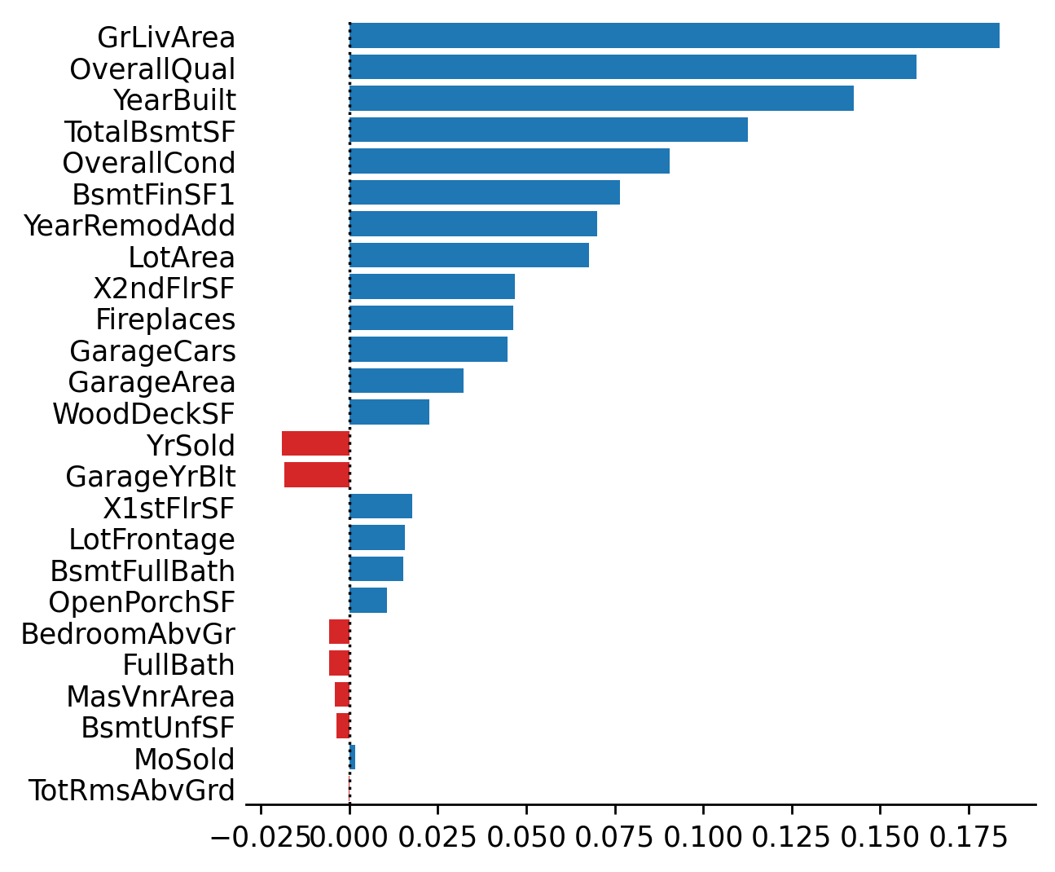
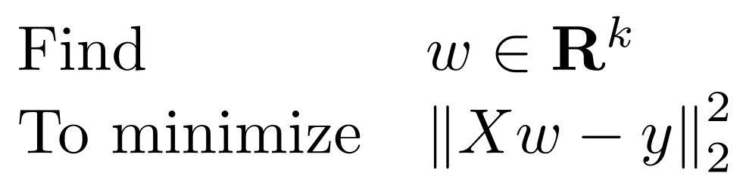
Linear regression
# Linear regression
model = LinearRegression()
model.fit(X, y)
yhat = model.predict(X)

Slide 14
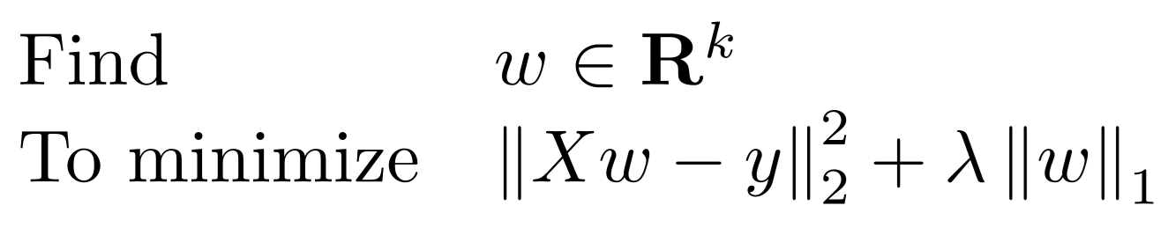
Lasso
# Linear regression with L¹ penalty
model = sklearn.linear_model.Lasso(alpha=1)
model.fit(X, y)
yhat = model.predict(X)
Statistical Learning with Sparsity, T. Hastie et al. (2015)

Slide 15
Lasso
import cvxpy as cp
w = cp.Variable(k)
intercept = cp.Variable(1)
residuals = y.values – ( intercept + X.values @ w.T )
objective = cp.sum_squares( residuals ) / n + alpha * cp.norm1(w)
prob = cp.Problem( cp.Minimize(objective), [] )
result = prob.solve()
w = pd.Series( w.value, index = X.columns )
w[ np.abs(w) < 1e-6 ] = 0
Statistical Learning with Sparsity, T. Hastie et al. (2015)

Slide 16

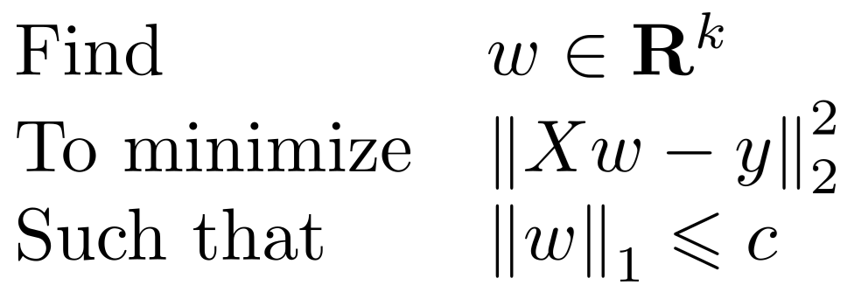
Lasso: sparsity
Statistical Learning with Sparsity, T. Hastie et al. (2015)

Slide 17
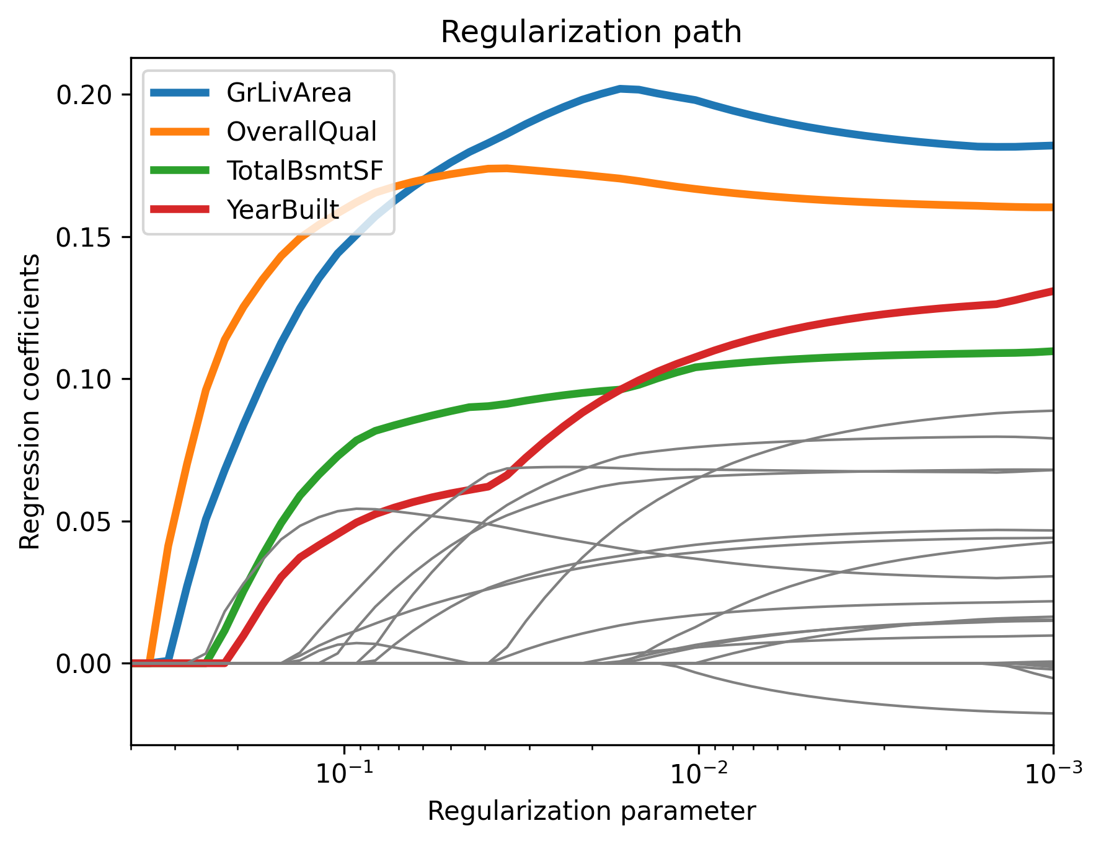
Lasso: regularization path
The output of the lasso is not a single model, but a family of models, increasingly complex: one for each value of λ.
Statistical Learning with Sparsity, T. Hastie et al. (2015)

Slide 18
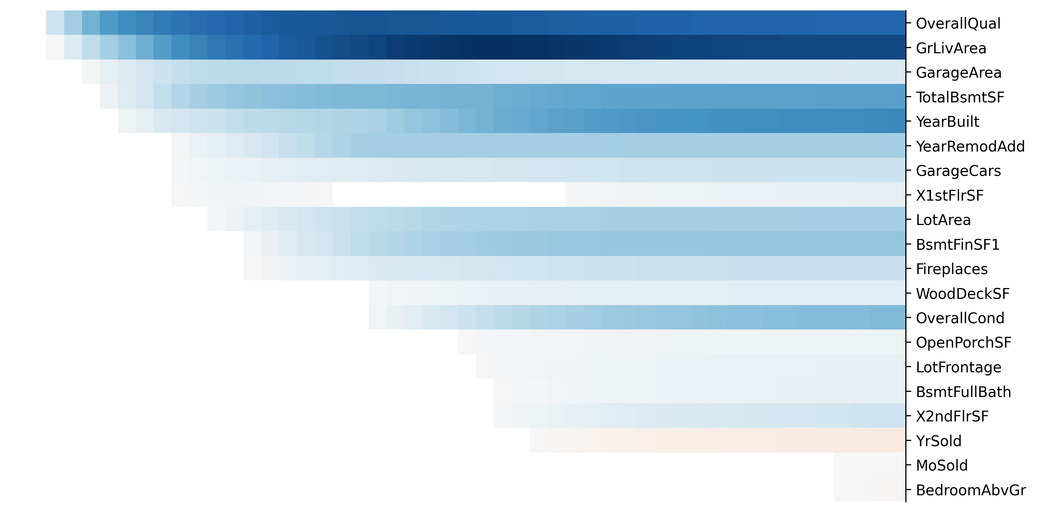
Lasso: regularization path
Statistical Learning with Sparsity, T. Hastie et al. (2015)

Slide 19
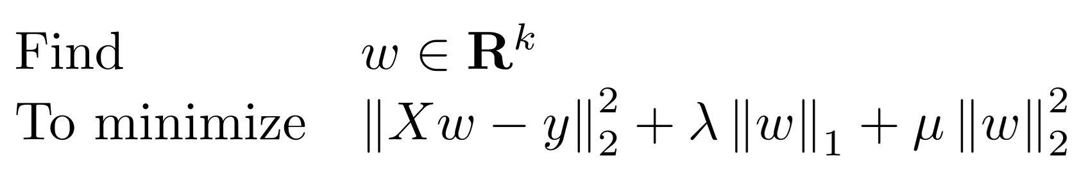
ElasticNet
# ElasticNet (linear regression with L¹ and L² penalties)
model = sklearn.linear_model.ElasticNet( alpha = alpha )
model.fit( X, y )
yhat = model.predict(X)
Statistical Learning with Sparsity, T. Hastie et al. (2015)

Slide 20

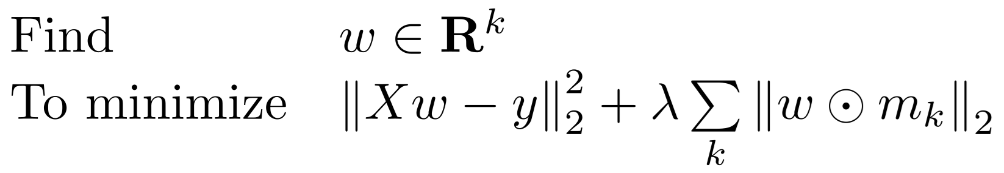
Group lasso
Boolean mask
# Group lasso (often used for the rows of a matrix)
w = cp.Variable(k)
intercept = cp.Variable(1)
residuals = y.values – ( intercept + X.values @ w.T )
objective = cp.sum_squares( residuals ) / n
for i in np.unique(c):
objective += alpha * cp.norm2( cp.multiply( (c==i), w ) )
prob = cp.Problem( cp.Minimize(objective), [] )
result = prob.solve()
w = pd.Series( w.value, index = X.columns )
L² norm, not squared
Statistical Learning with Sparsity, T. Hastie et al. (2015)

Slide 21
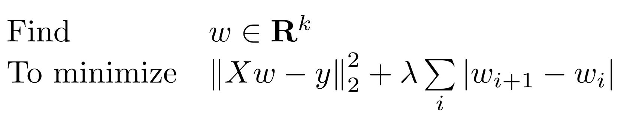
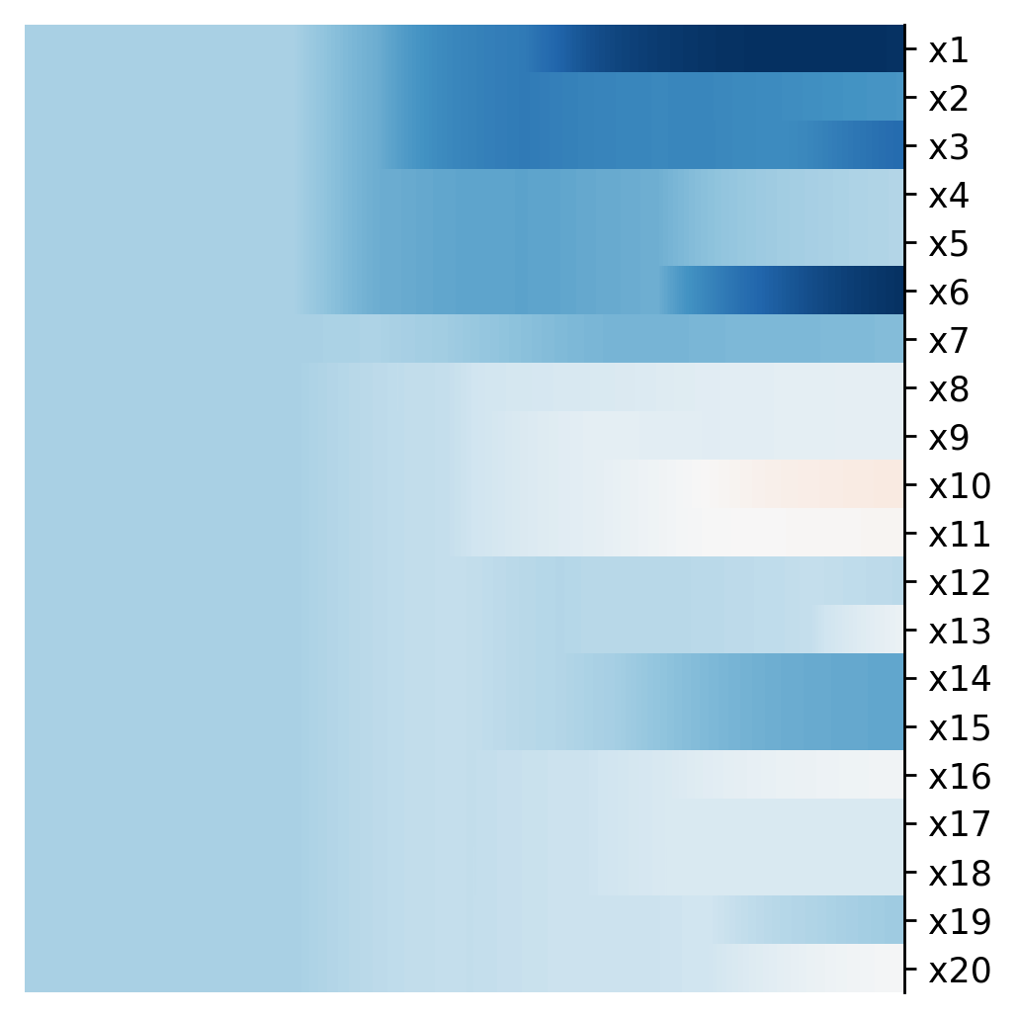
Fused lasso
# Fused lasso
w = cp.Variable(k)
intercept = cp.Variable(1)
residuals = y.values – ( intercept + X.values @ w.T )
objective = cp.sum_squares( residuals ) / n + alpha
for i in range(1,k):
objective += alpha * cp.abs( w[i] - w[i-1] )
prob = cp.Problem( cp.Minimize(objective), [] )
result = prob.solve()
w = pd.Series( w.value, index = X.columns )
Statistical Learning with Sparsity, T. Hastie et al. (2015)

Slide 22
Fused lasso
…
i-2
i-1
i
i+1
i+2
…
Statistical Learning with Sparsity, T. Hastie et al. (2015)

Slide 23
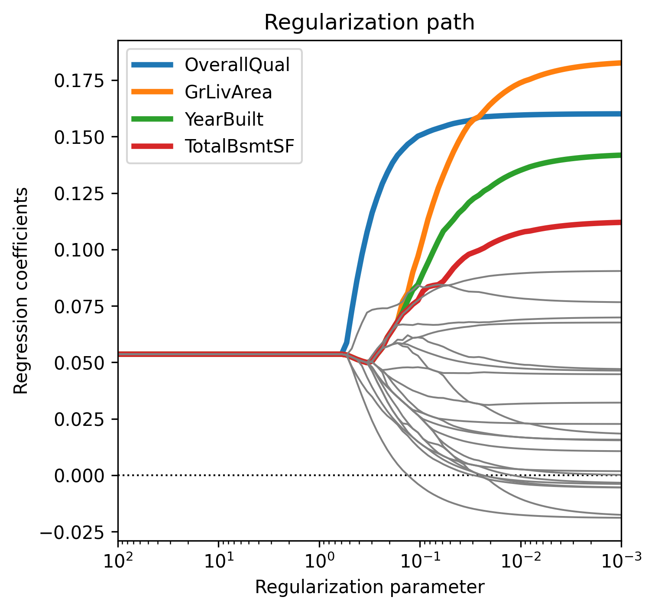
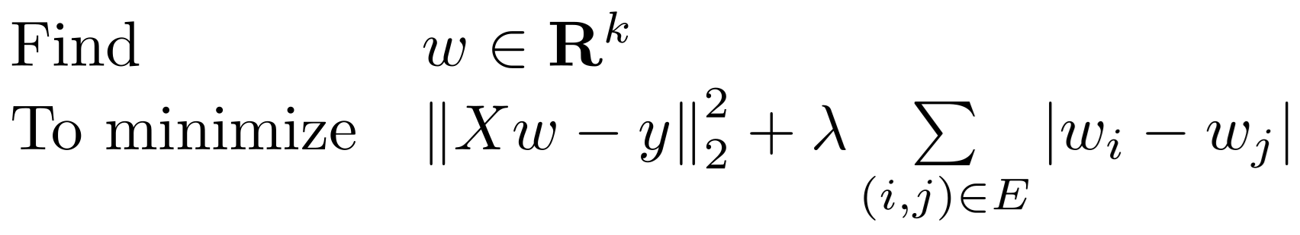
Graph sparsity
# Graph sparsity
w = cp.Variable(k)
intercept = cp.Variable(1)
residuals = y.values – (intercept + X.values @ w.T)
objective = cp.sum_squares( residuals ) / n
for i,j in g.edges:
p = alpha * cp.abs( w[i] - w[j] )
objective += p / len(g.edges)
prob = cp.Problem( cp.Minimize(objective), [] )
result = prob.solve()
w = pd.Series( w.value, index = X.columns )
Statistical Learning with Sparsity, T. Hastie et al. (2015)

Slide 24
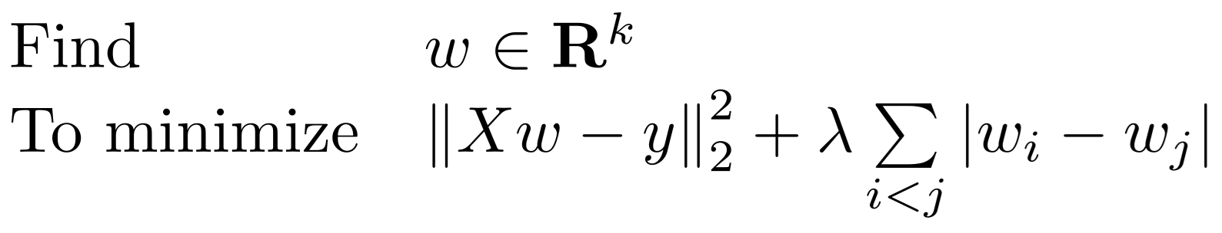
Graph sparsity
# Graph sparsity (complete graph)
w = cp.Variable(k)
intercept = cp.Variable(1)
residuals = y.values – (intercept + X.values @ w.T)
objective = cp.sum_squares( residuals ) / n
for i in range(k):
for j in range(i+1,k):
p = alpha * cp.abs( w[i] - w[j] )
objective += p / k / (k-1) * 2
prob = cp.Problem( cp.Minimize(objective), [] )
result = prob.solve()
w = pd.Series( w.value, index = X.columns )
Statistical Learning with Sparsity, T. Hastie et al. (2015)

Slide 25
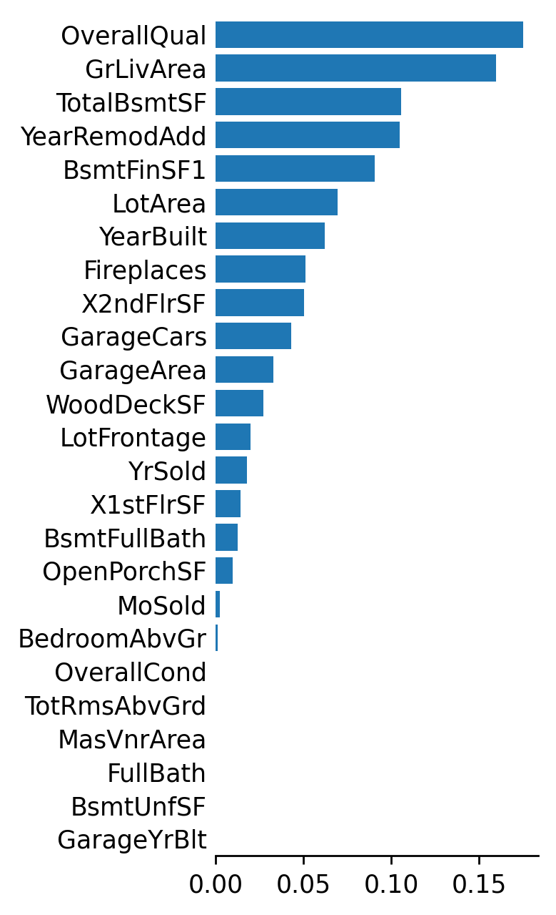
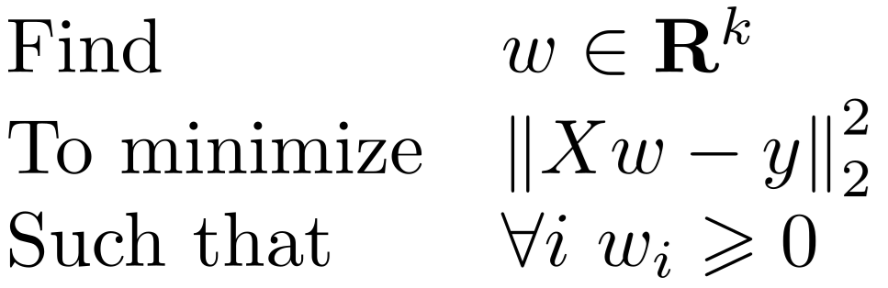
Sign constraints
# Linear regression with sign constraints
model = LinearRegression( positive = True )
model.fit(X, y)
yhat = model.predict(X)

Slide 26
Sign constraints
# Linear regression with sign constraints
n, k = X.shape
w = cp.Variable(k)
intercept = cp.Variable(1)
residuals = y.values – (intercept + (X * signs).values @ w.T)
objective = cp.sum_squares( residuals ) / n
constraints = [ w >= 0 ]
prob = cp.Problem( cp.Minimize(objective), constraints )
result = prob.solve()
w = pd.Series( w.value, index = X.columns )

Slide 27
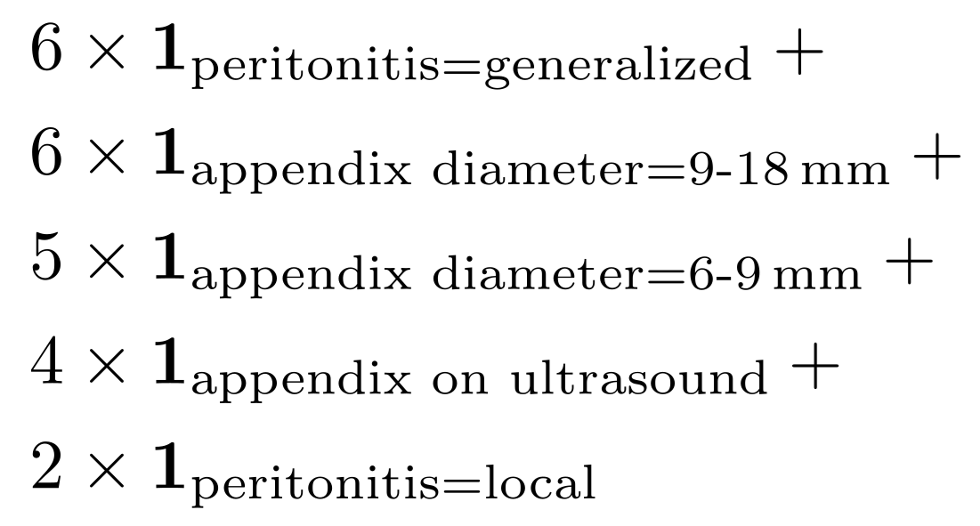
SLIM
Combine binary inputs with simple integer coefficients
Supersparse linear integer model for interpretable classification, B. Ustun et al. (2013)

Slide 28
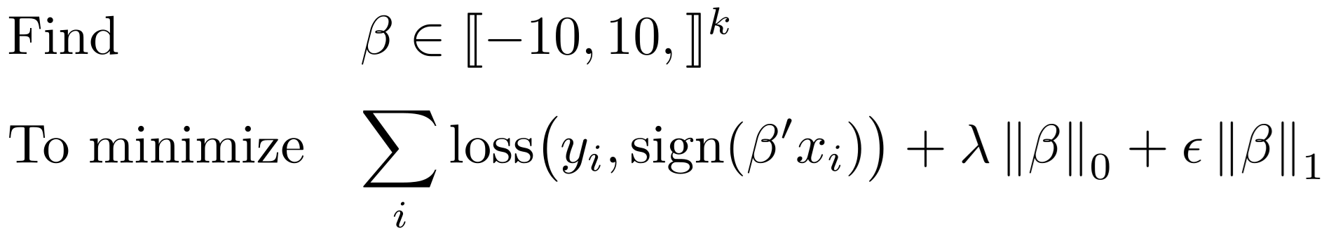
SLIM
We want many of the βᵢ to be 0
0-1 loss
Small ℓ¹ penalty
Binary output: ±1
Binary inputs: ±1
Supersparse linear integer model for interpretable classification, B. Ustun et al. (2013)

Slide 29
Machine Learning

Slide 30
Machine Learning
Decision trees, falling rule lists
Monotonic decision trees
Monotonic gradient boosting
Generalized additive models (GAM)
GAM with interactions
GAM boosting
Additive index models (AIM)
Symbolic regression

Slide 31
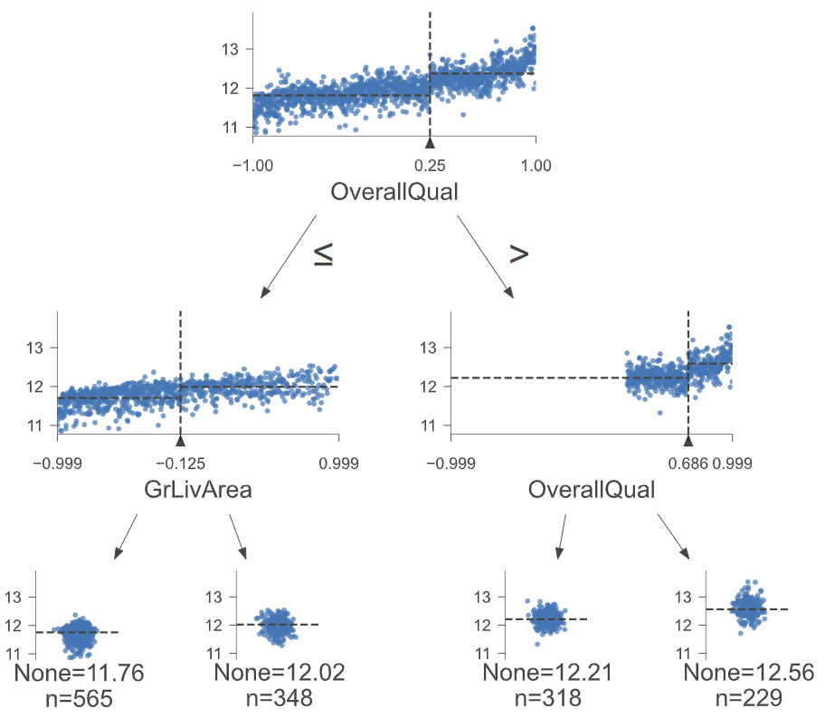
Decision tree

Slide 32
Monotonic decision tree
# Decision tree with a monotonicity constraint
model = sklearn.tree.DecisionTreeRegressor(
monotonic_cst = [ signs[u] for u in X.columns ],
)
model.fit( X, y )

Slide 33
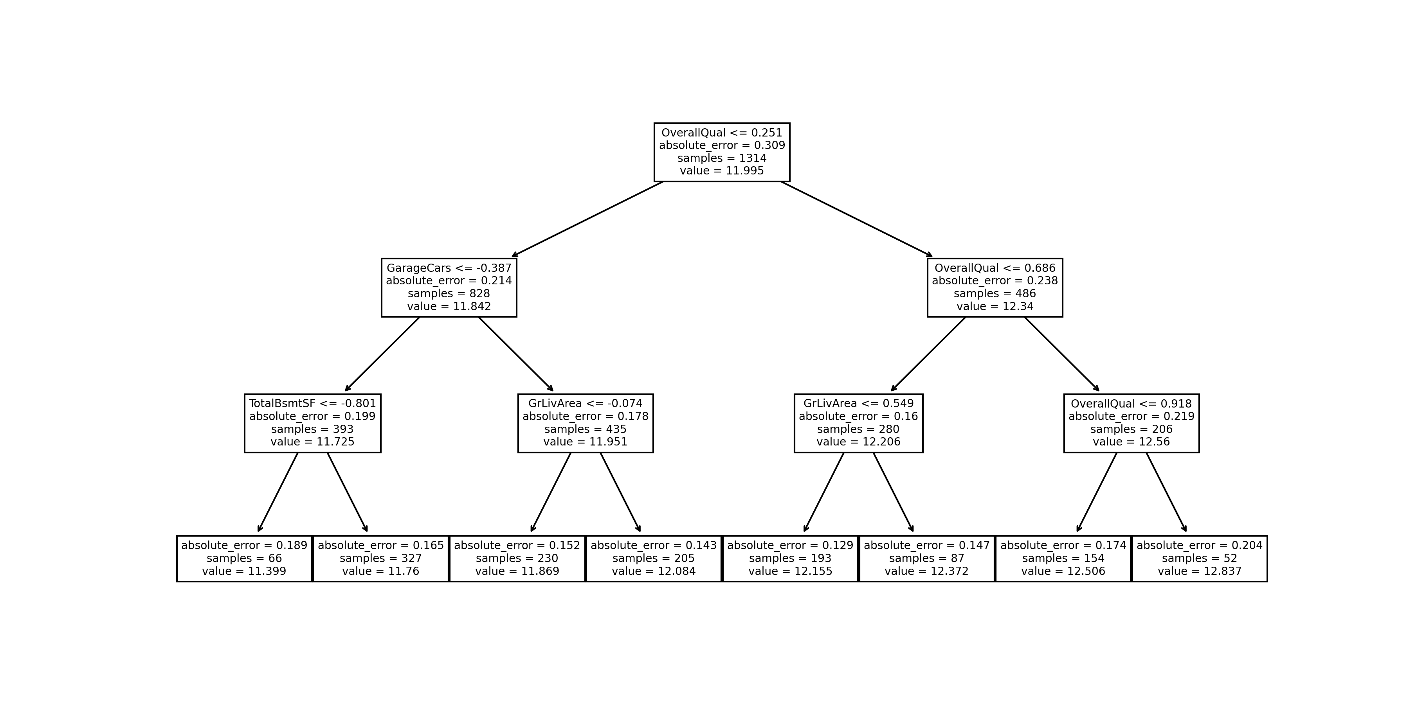
Falling rule lists
An optimization approach to learning falling rule lists, C. Chen and C. Rudin (2017)

Slide 34
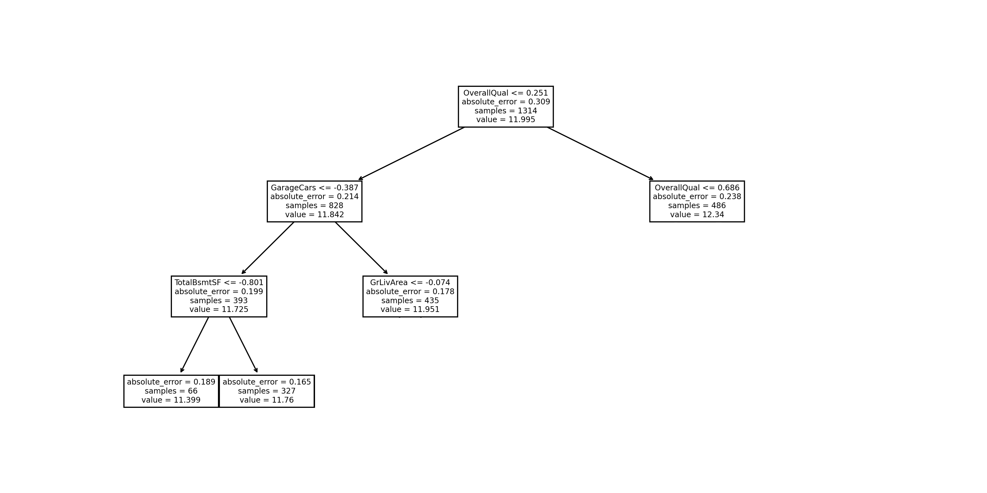
Falling rule lists
An optimization approach to learning falling rule lists, C. Chen and C. Rudin (2017)

Slide 35
Falling rule lists
An optimization approach to learning falling rule lists, C. Chen and C. Rudin (2017)

Slide 36
Boosting
Fit a simple (“base”) model to the data
Fit another base model to misclassified data
Combine them
Iterate
The final model is a linear combination of base models

Slide 37
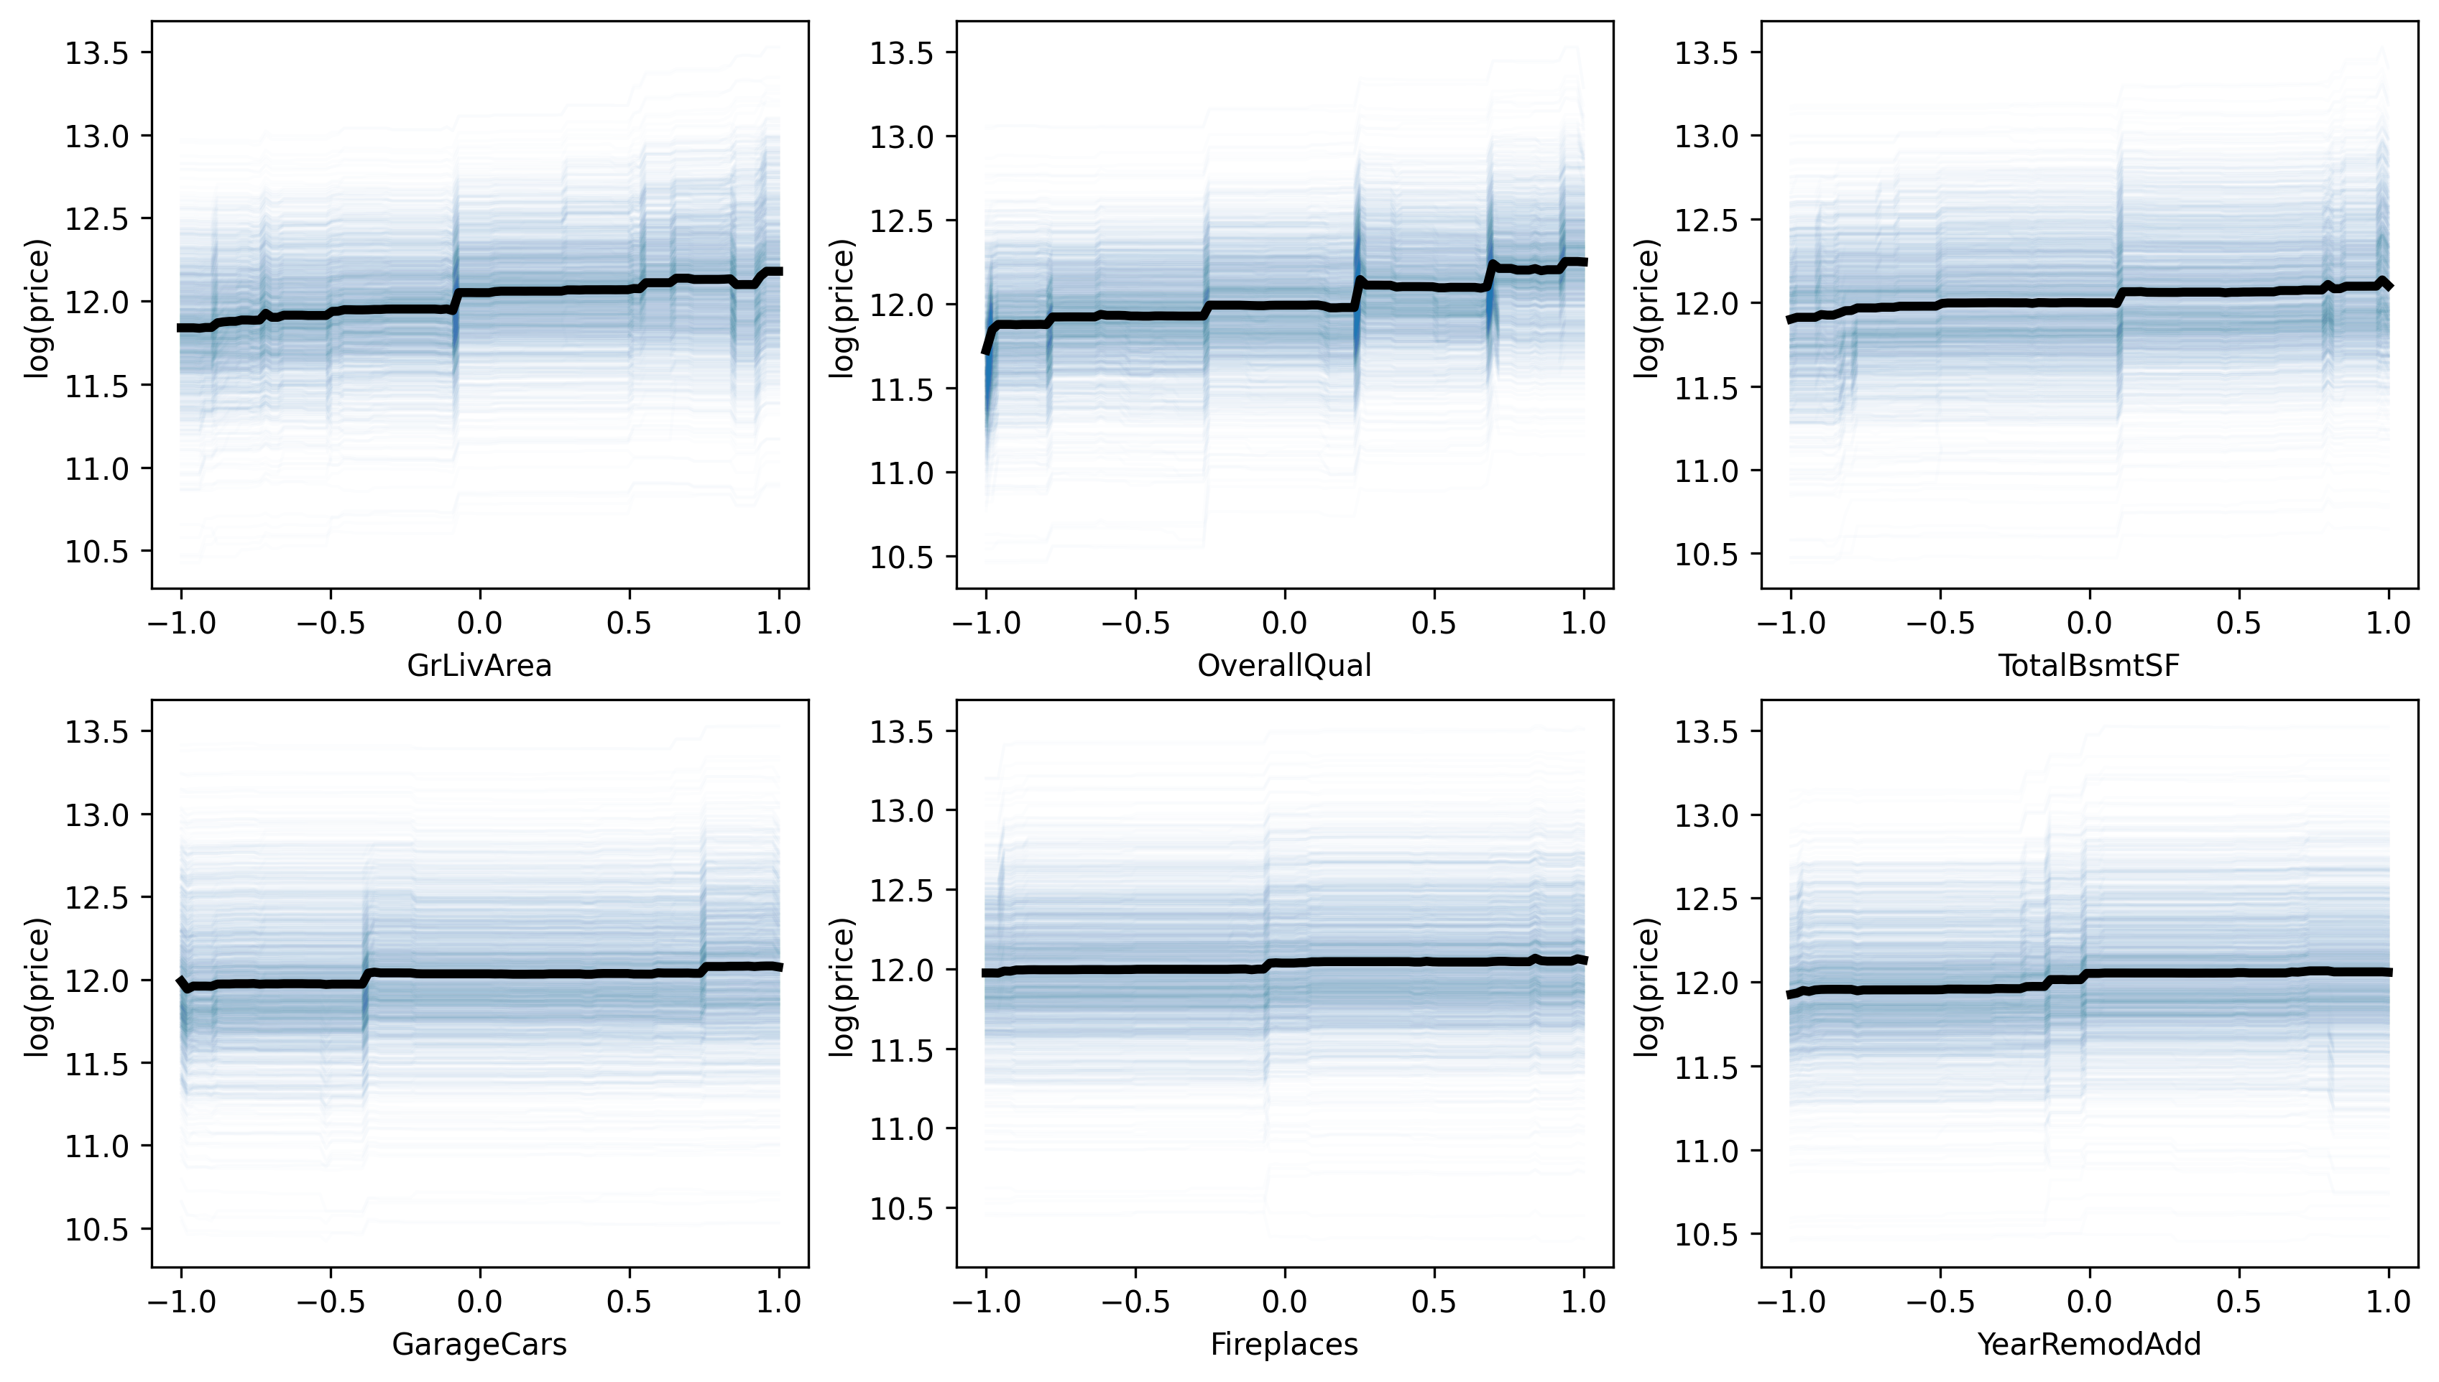
Gradient boosting

Slide 38
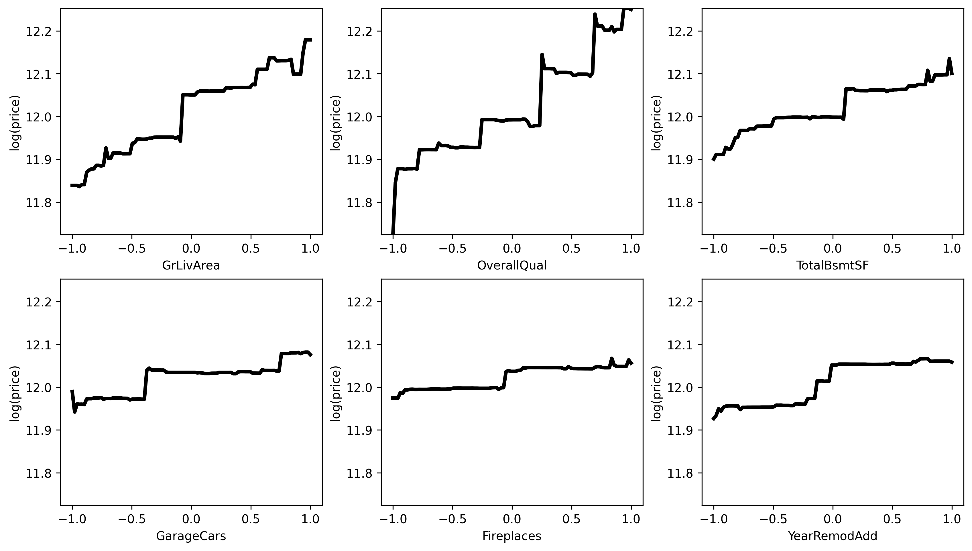
Gradient boosting

Slide 39
Gradient boosting
# Gradient boosting with a monotonicity constraint
model = xgboost.XGBRegressor(
monotone_constraints = { k: int(v) for k,v in signs.items() },
)
model = lightgbm.LGBMRegressor(
monotone_constraints = [ signs[u] for u in X.columns ],
)
model = catboost.CatBoostRegressor(
verbose = False,
monotone_constraints = [ signs[u] for u in X.columns ],
)

Slide 40
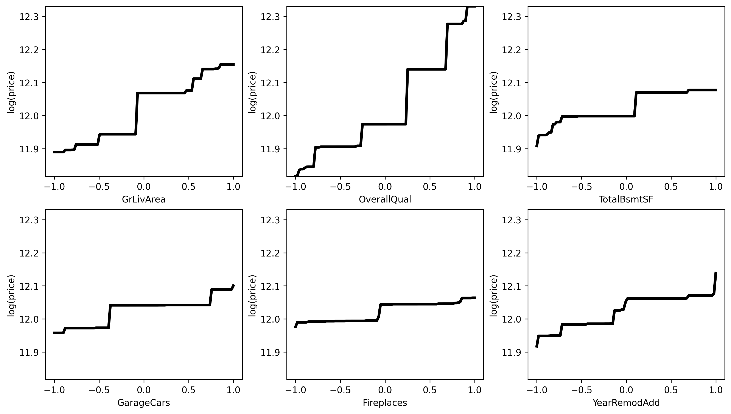
Gradient boosting

Slide 41
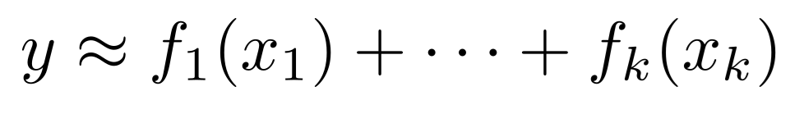
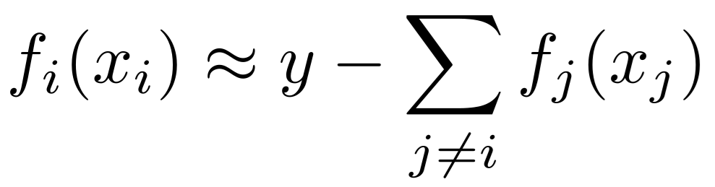
GAM
Find functions f₁,...,fₖ such that The fᵢ's are often modeled with splines, and “backfitted”:
Generalized additive models (S.N. Wood, 2017)

Slide 42
GAM
Find functions f₁,...,fₖ such that
# Generalized additive model (GAM) with a monotonicity constraint
constraints = [
'monotonic_inc' if signs[u] > 0 else 'monotonic_dec'
for u in X.columns
]
gam = LinearGAM(constraints=constraints).fit(X,y)
https://pygam.readthedocs.io/en/latest/

Slide 43
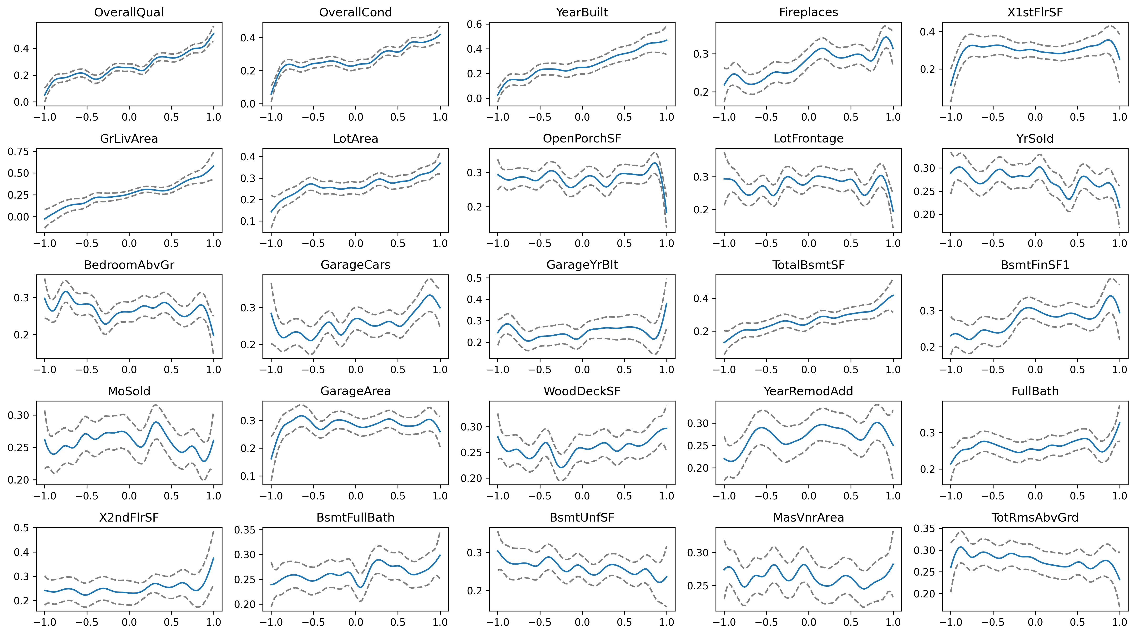
GAM

Slide 44
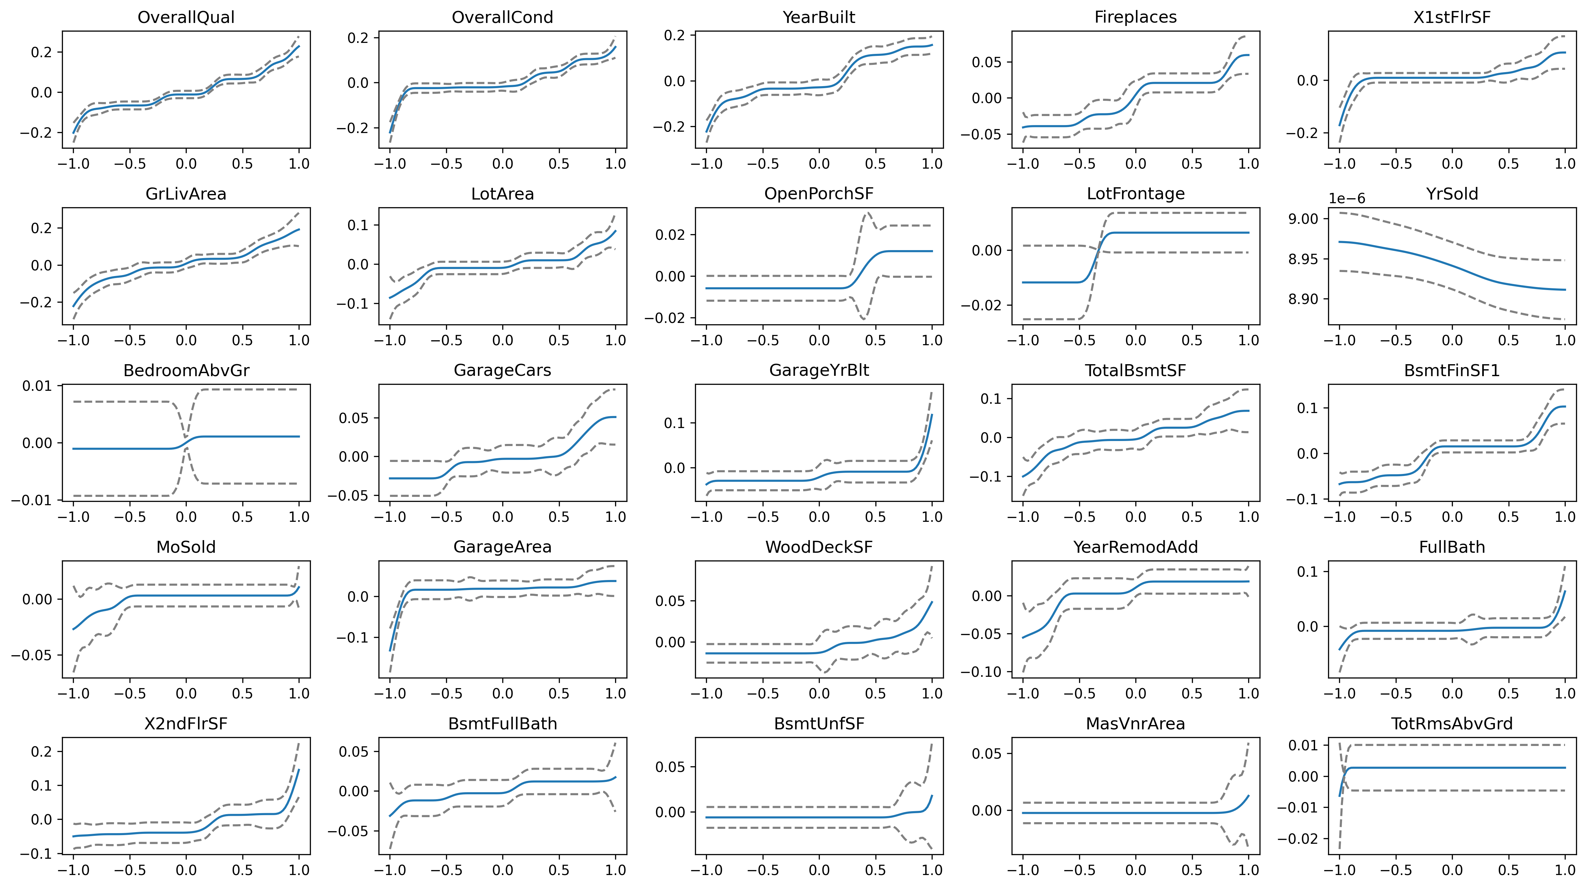

Slide 45
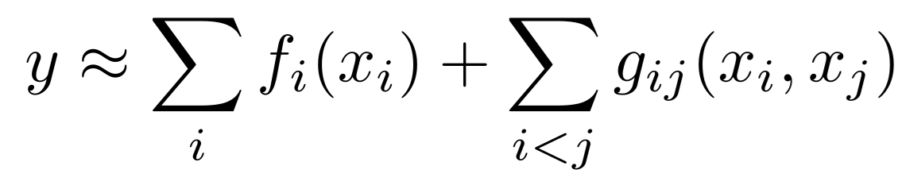
GAM with interactions (GA²M)

Slide 46
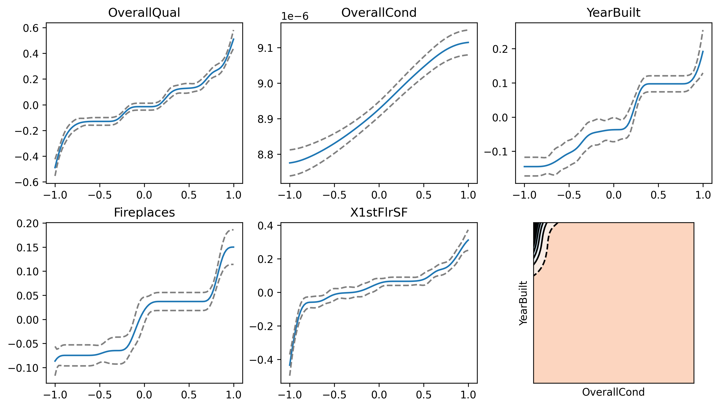
GA²M

Slide 47
GAM Boosting
Boosting with GAMs as base learners:
The variables enter the model one by one
They are transformed in increasingly complex (nonlinear) ways
This gives a GAM regularization path.
# GAM Boosting (this is R code)
mboost::gamboost( y ~ ., data = d )
Model-based boosting in R: a hands-on tutorial using the R package mboost (B. Hofner et al., 2014)

Slide 48
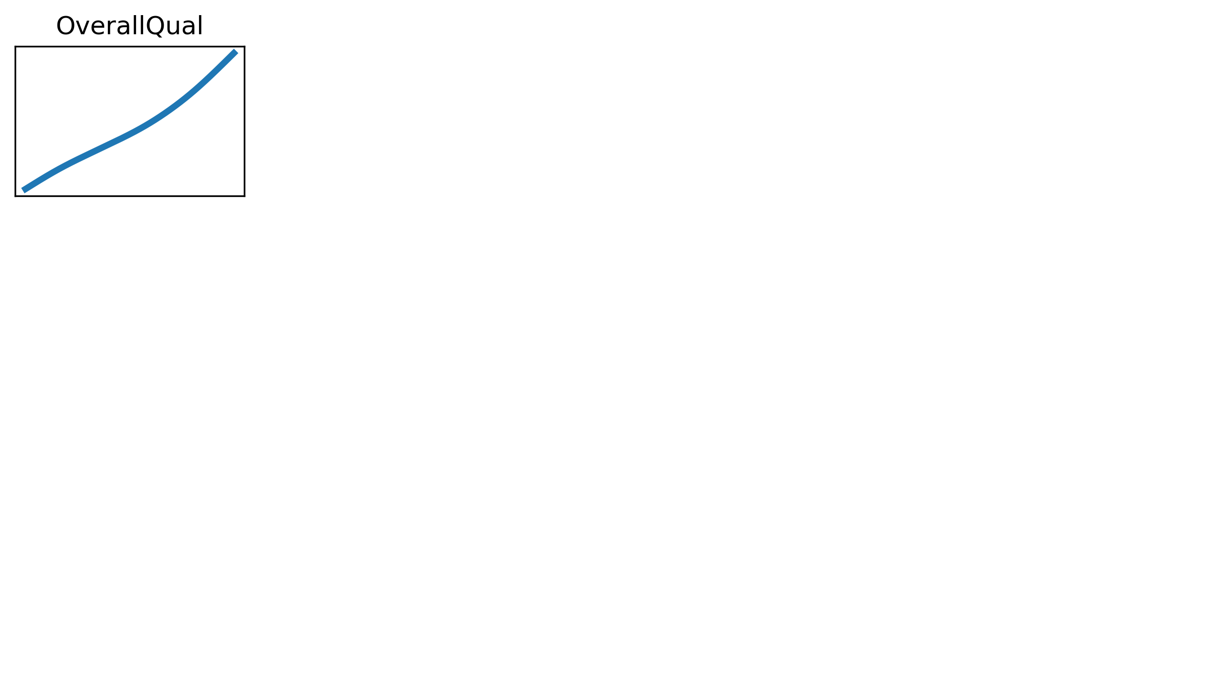

Slide 49
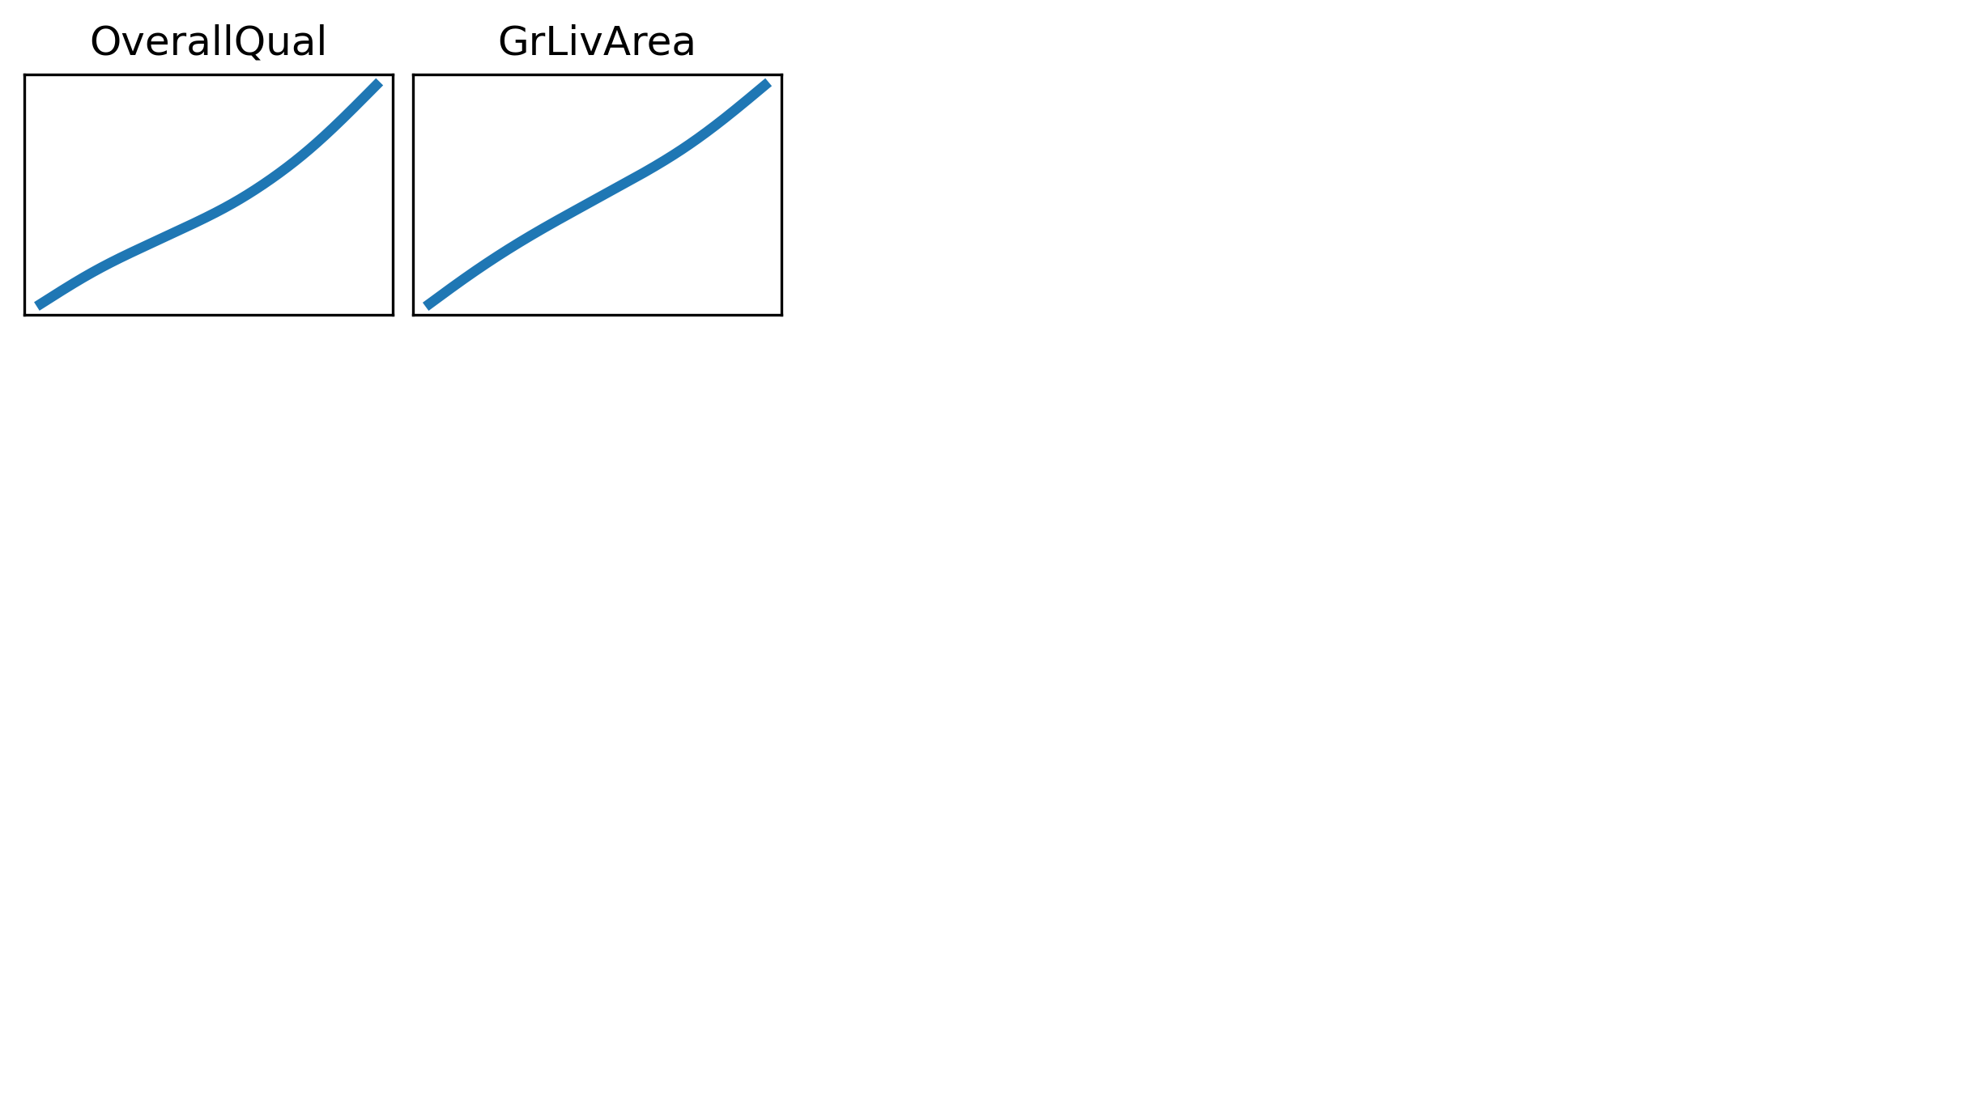

Slide 50
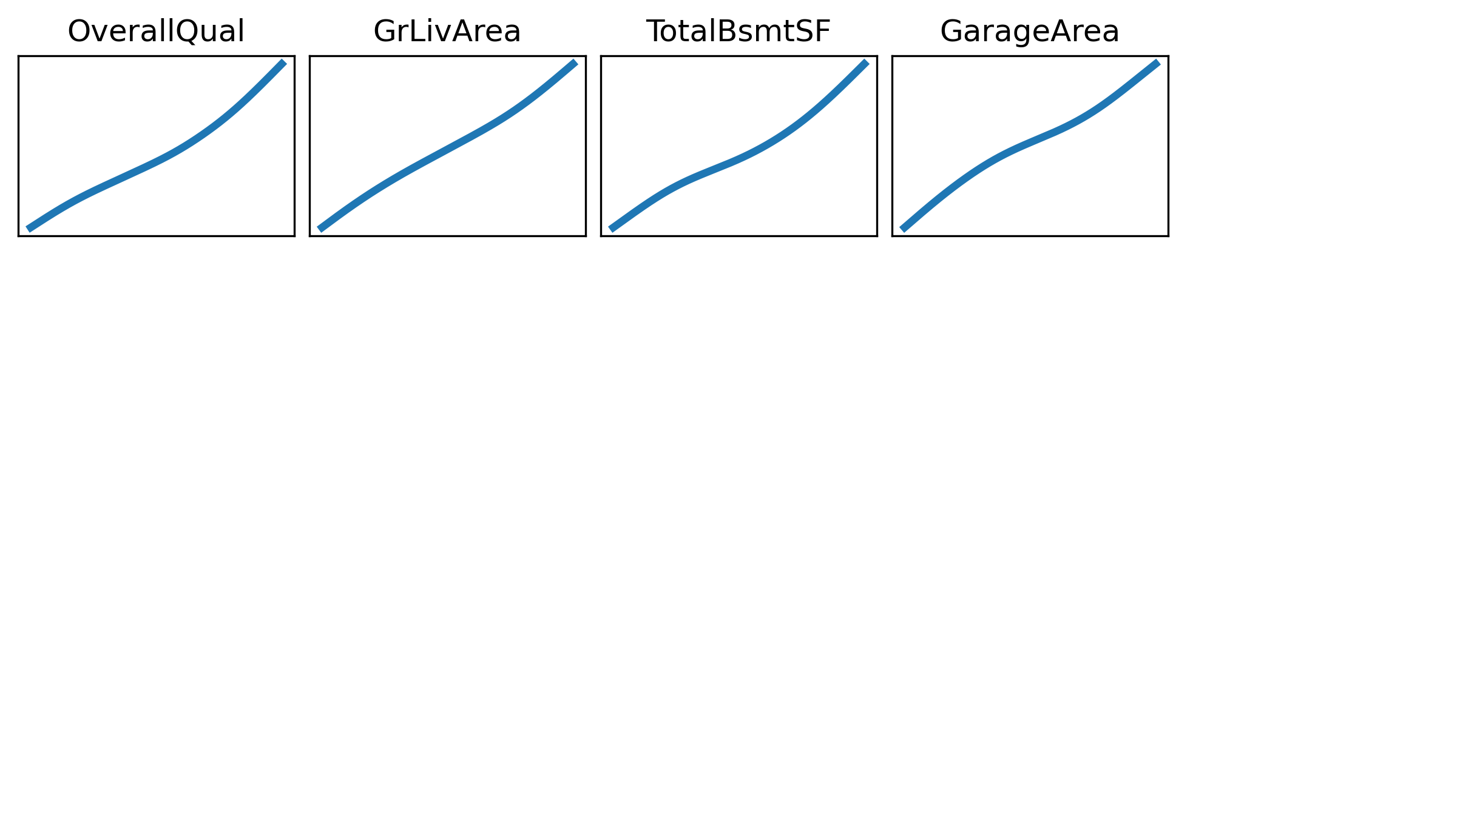

Slide 51
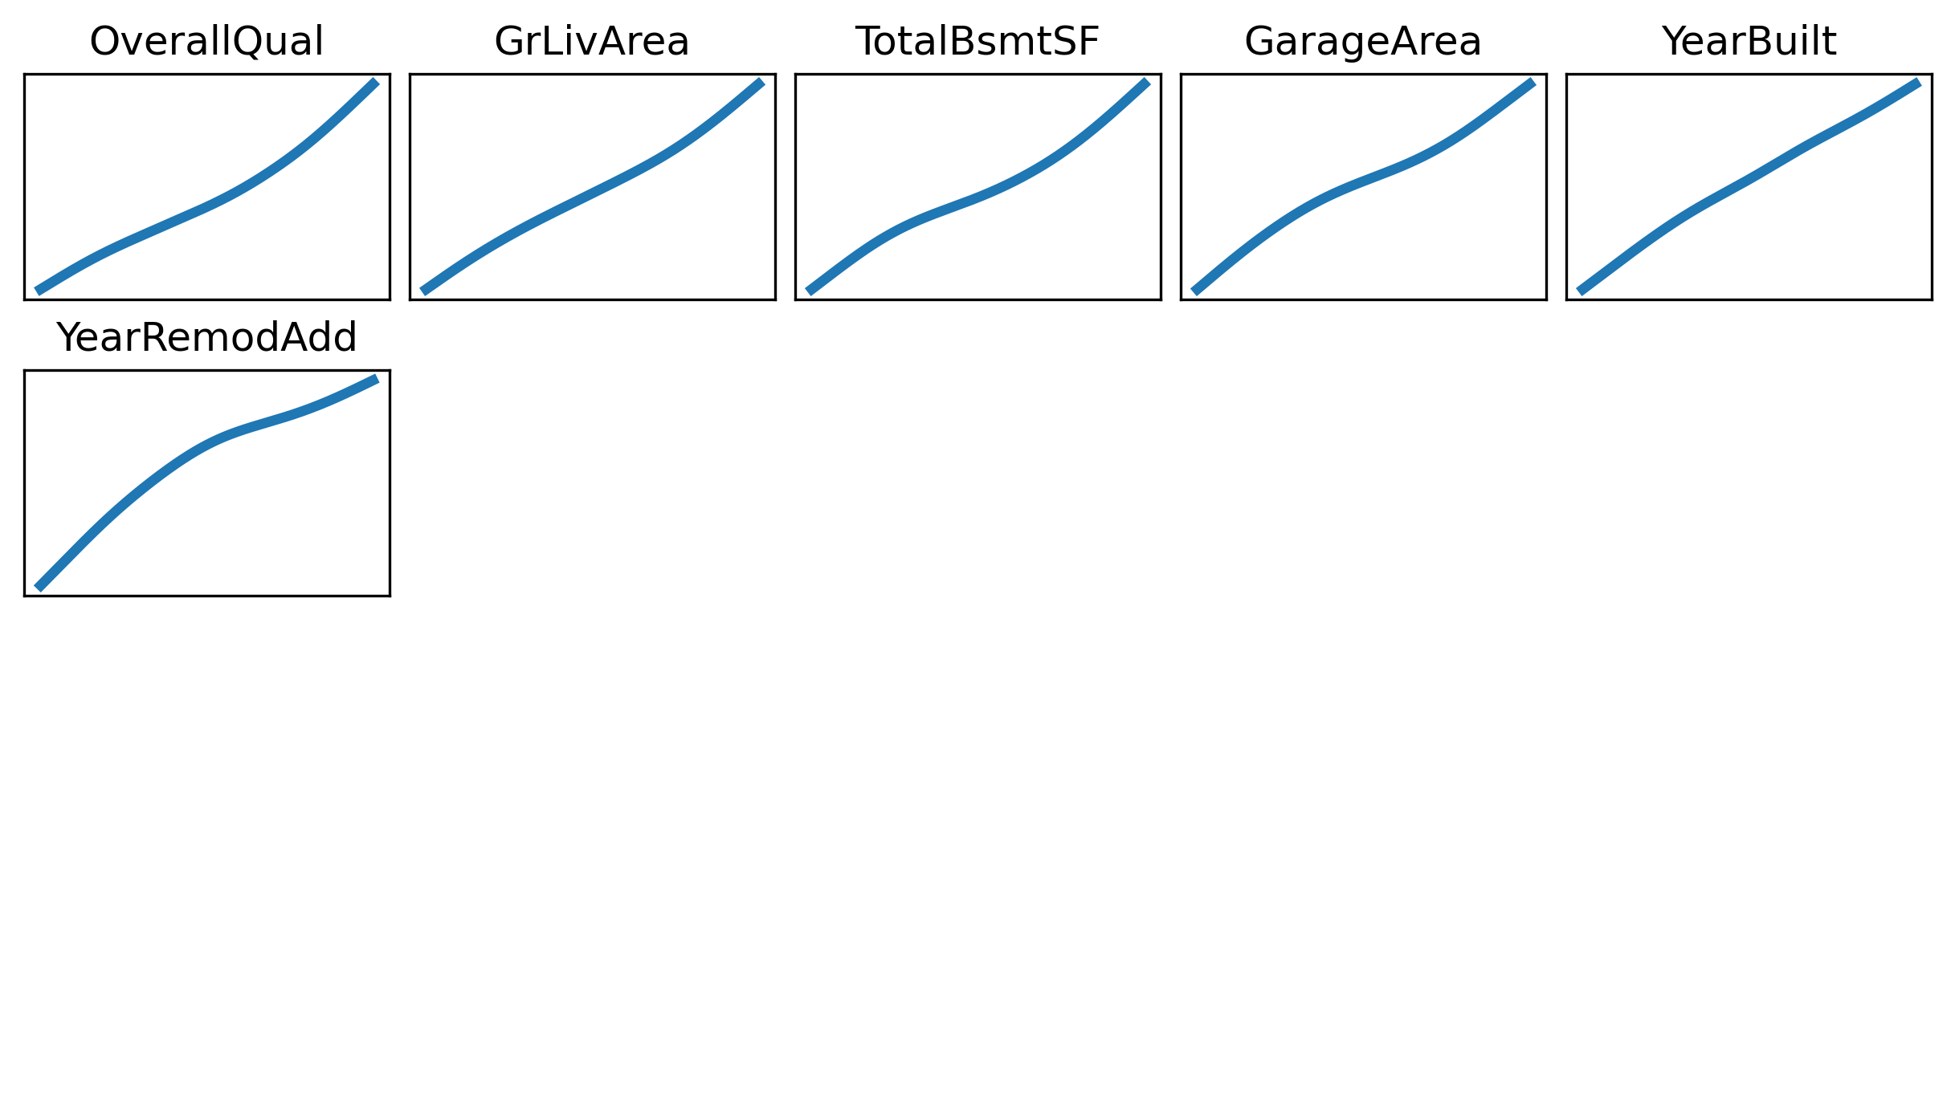

Slide 52
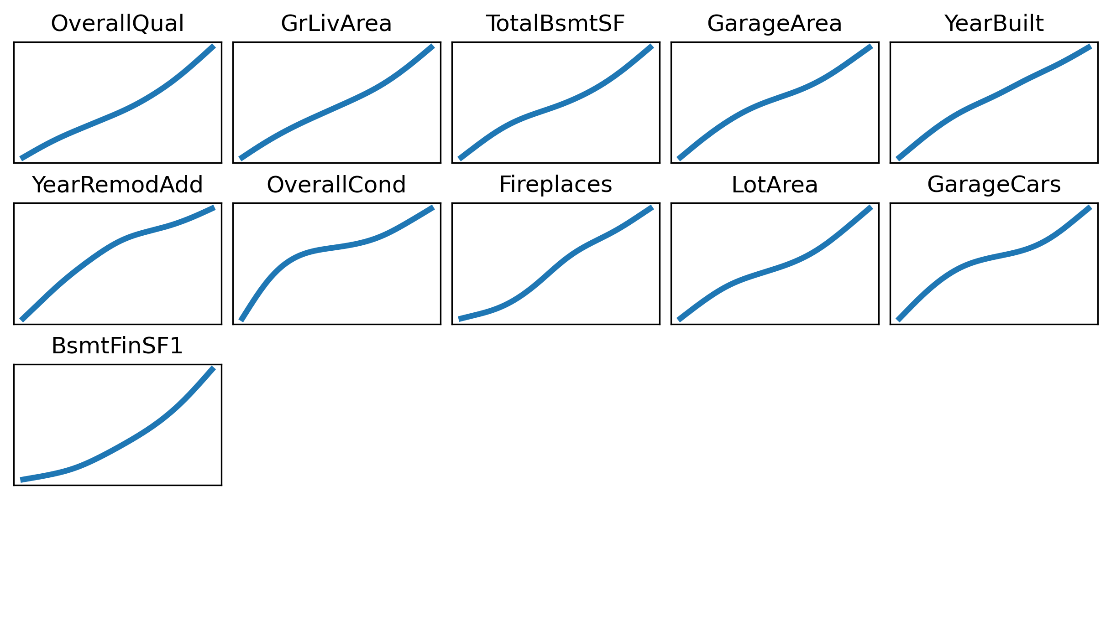

Slide 53
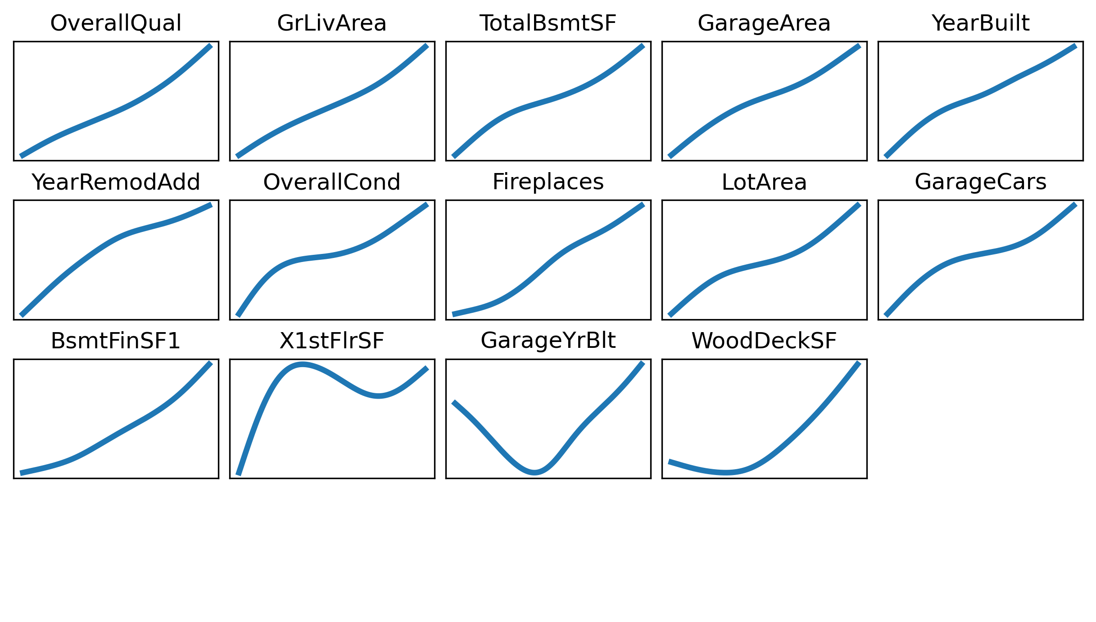

Slide 54
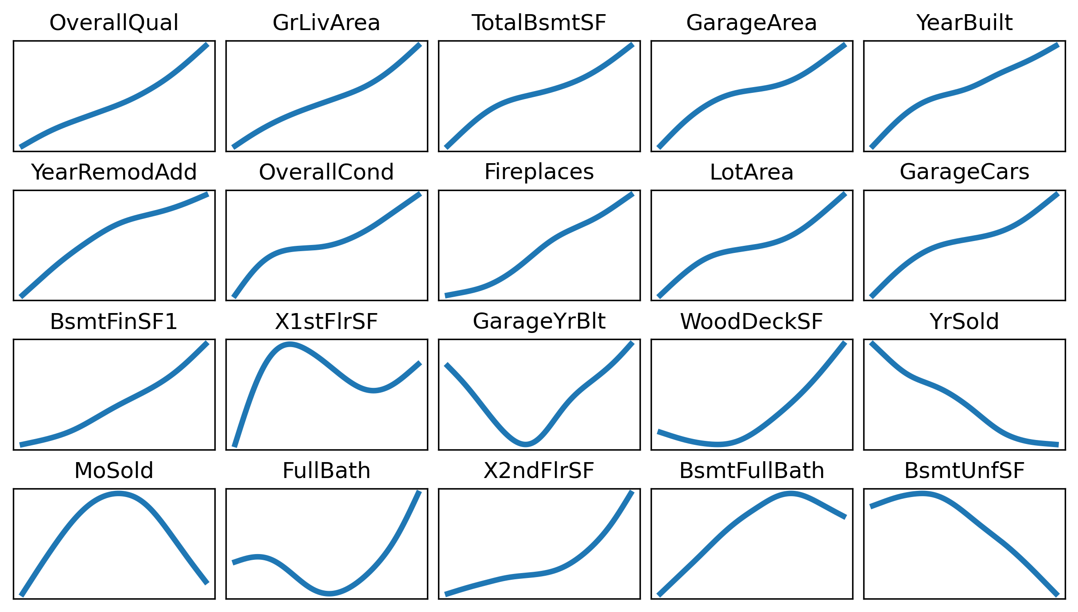

Slide 55
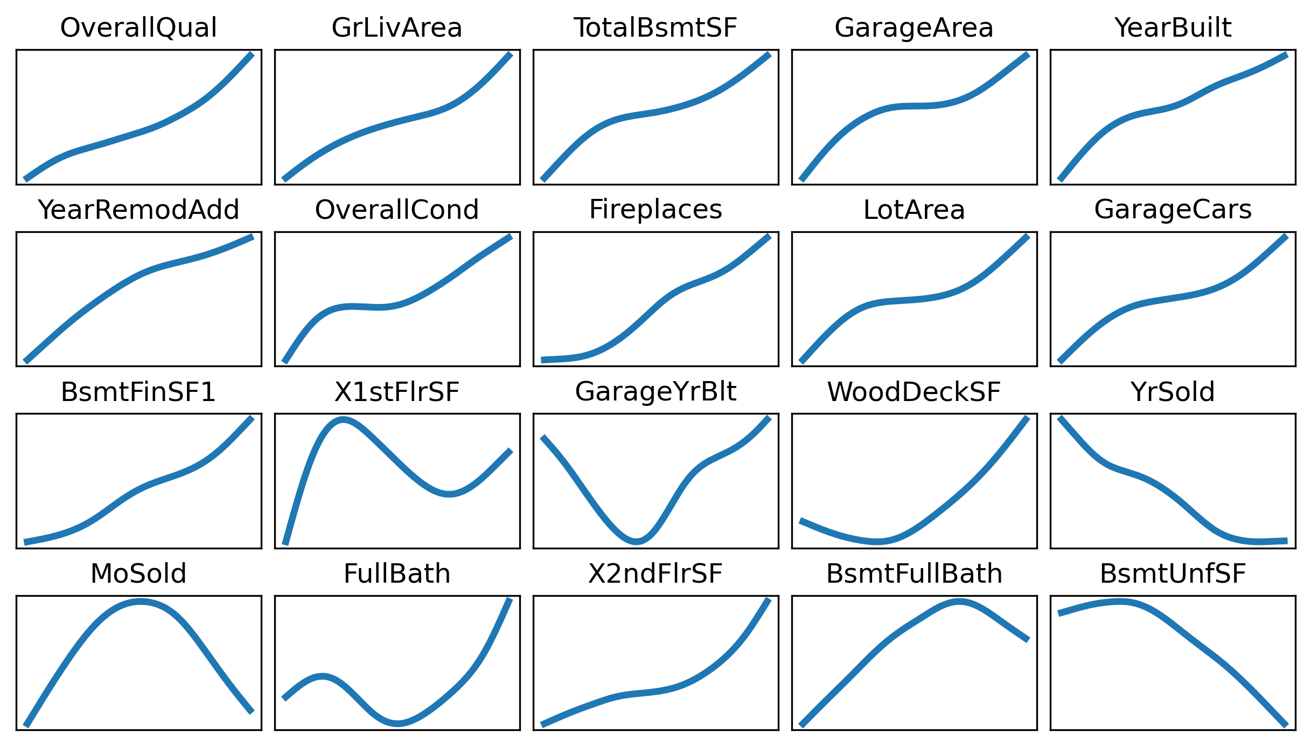

Slide 56
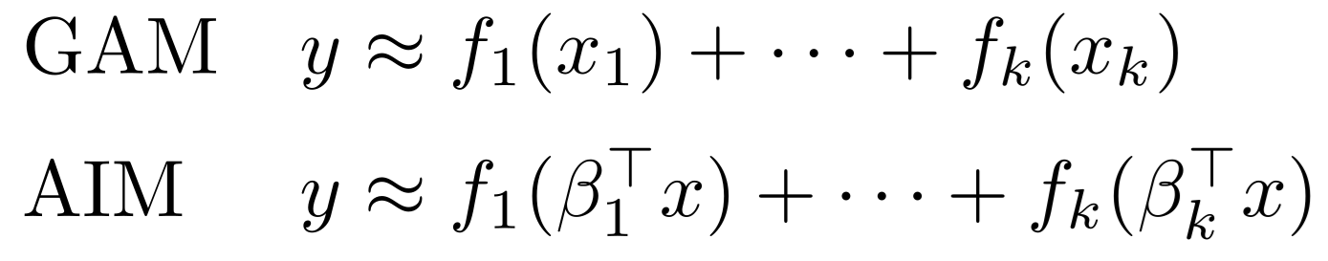
Additive index models
For better interpretability:
Add an orthogonality penalty on β, ‖B'B-I‖²
Add a sparsity penalty, ‖B‖₁

Slide 57
class AIM(nn.Module):
"""
Additive Index Model:
y ≈ f₁(β₁'x) + ⋯ + fₖ(βₖ'x)
Model f₁,...,fₖ as neural nets (I used one hidden layer and ReLU activations)
"""
def __init__(self, n_input, n_terms, n_nodes, activation = F.relu):
super(AIM, self).__init__()
self.fc = nn.Linear(n_input, n_terms, bias=False)
self.W1 = nn.Parameter( torch.Tensor(n_terms, n_nodes) )
self.b1 = nn.Parameter( torch.Tensor(n_terms, n_nodes) )
self.W2 = nn.Parameter( torch.Tensor(n_terms, n_nodes) )
self.b = nn.Parameter( torch.Tensor(1) )
self.activation = activation
self.reset_parameters()
def reset_parameters(self):
for p in self.parameters():
nn.init.uniform_(p, -1, 1)
def project(self, x):
return self.fc(x) # βᵢ'x
def transform(self, h):
h = torch.einsum( 'ik,kl->ikl', h, self.W1 ) # No summation
h = h + self.b1
h = self.activation(h)
h = torch.einsum( 'ikl,kl->ik', h, self.W2 ) # fᵢ(βᵢ'x)
return h
def forward(self, x):
h = self.project(x)
h = self.transform(h)
h = torch.einsum( 'ik->i', h )
h = h + self.b
return h

Slide 58
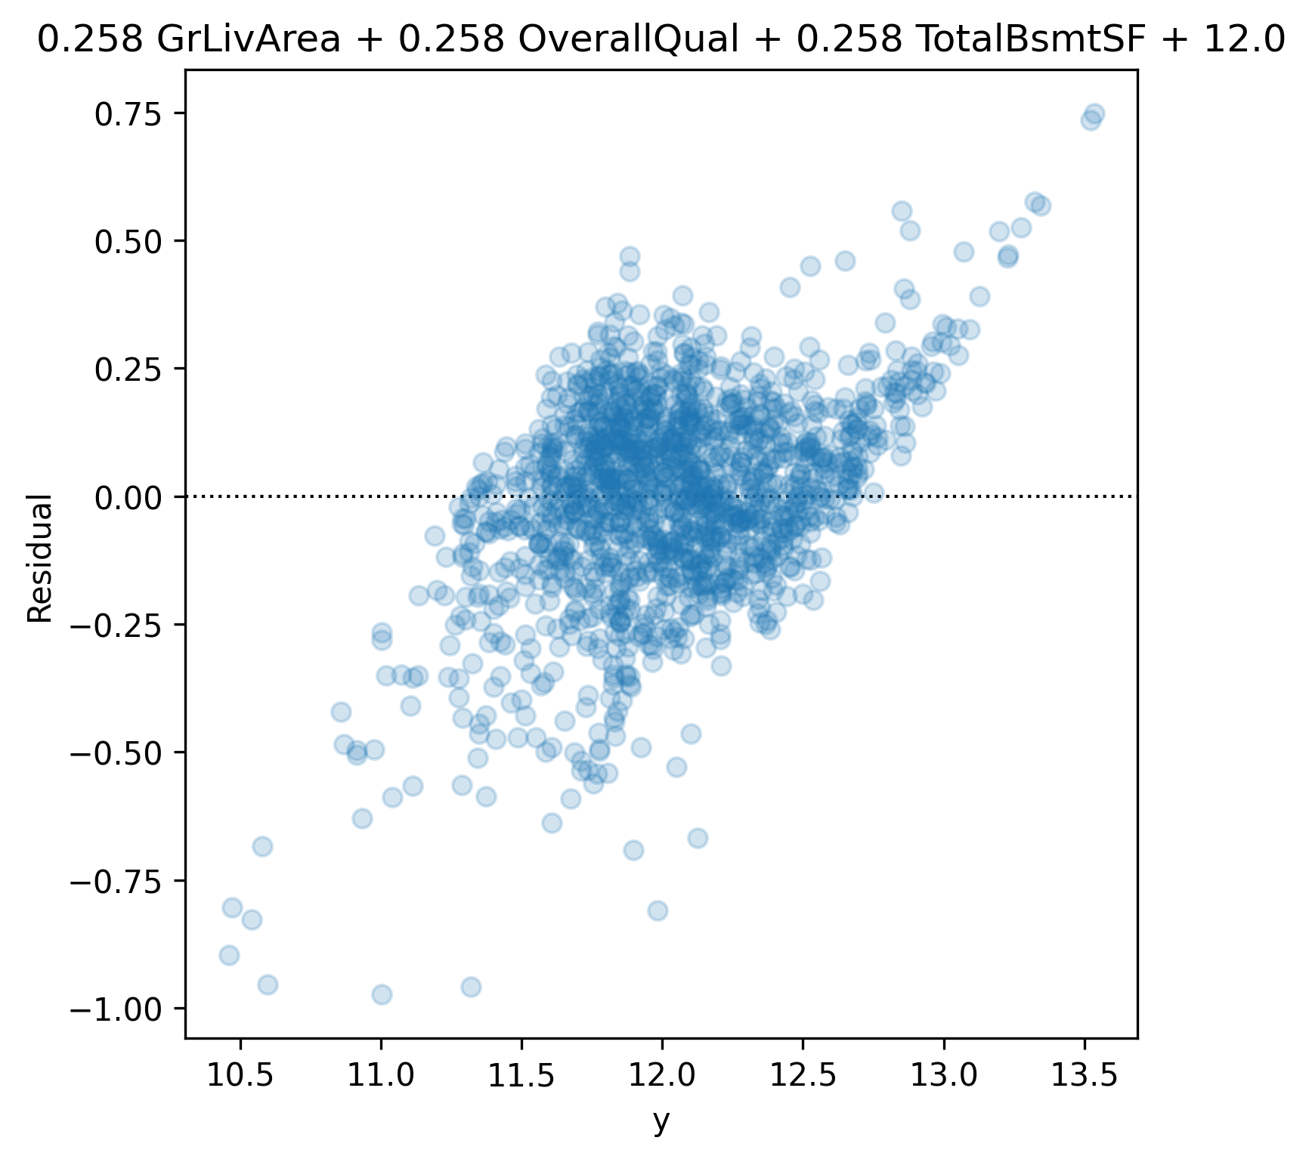
Symbolic regression
Find a simple formula fitting the data, using +, -, ×, /, ^, log, exp, sin, cos.
Works best in physics, with few variables and lots of data.
Interpretable machine learning for science with PySR and SymbolicRegression.jl, M. Cranmer (2023)

Slide 59
Code: symbolic regression
# Symbolic regression (example from the documentation)
model = PySRRegressor(
niterations = 40,
binary_operators = ["+", "*"],
unary_operators = [
"cos",
"exp",
"sin",
"inv(x) = 1/x",
],
extra_sympy_mappings = {"inv": lambda x: 1 / x},
elementwise_loss = "loss(prediction, target) = (prediction - target)^2",
)
model.fit(X,y)
f = model.get_best()['lambda_format'] # Callable
Interpretable machine learning for science with PySR and SymbolicRegression.jl, M. Cranmer (2023)

Slide 60
Deep Learning

Slide 61
Deep learning
Sparse-input neural nets
GAMI-Net
Monotonic MLP: gradient penalty, MIP monotonicity proof, adversarial training
Varying coefficient models, self-explaining neural nets
Mixtures of experts

Slide 62
MLP
X
class Net(nn.Module):
def __init__(self, n_input, k1, k2):
super(Net, self).__init__()
self.fc1 = nn.Linear(n_input, k1)
self.fc2 = nn.Linear(k1, k2)
self.fc3 = nn.Linear(k2, 1)
def forward(self, x):
h1 = F.relu( self.fc1(x) )
h2 = F.relu( self.fc2(h1) )
return self.fc3(h2)
model = Net( X.shape[1], 200, 200 )
optimizer = optim.Adam( model.parameters() )
loss_fn = nn.MSELoss(reduction='mean')
for epoch in range(10_000):
optimizer.zero_grad()
y_hat = model(X)
loss = loss_fn( y_hat, y )
loss.backward()
optimizer.step()
linear
ReLU
linear
ReLU
linear
y

Slide 63
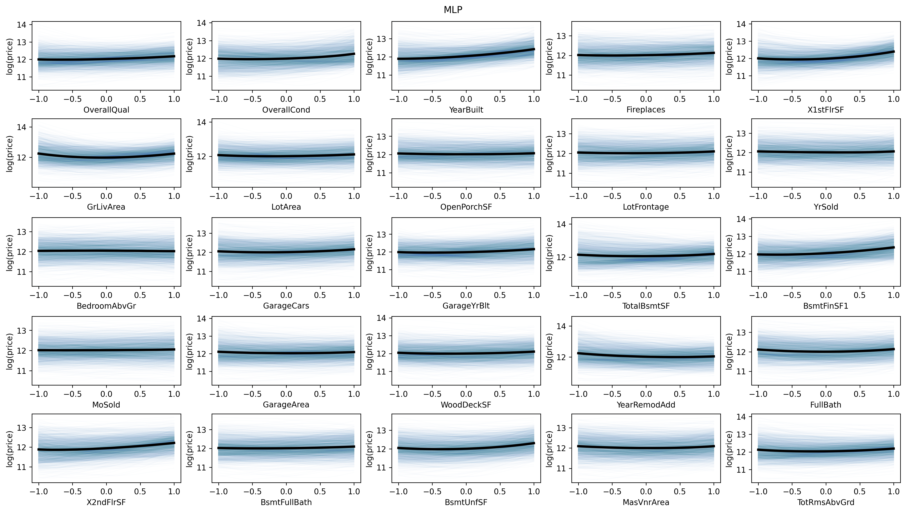
MLP

Slide 64
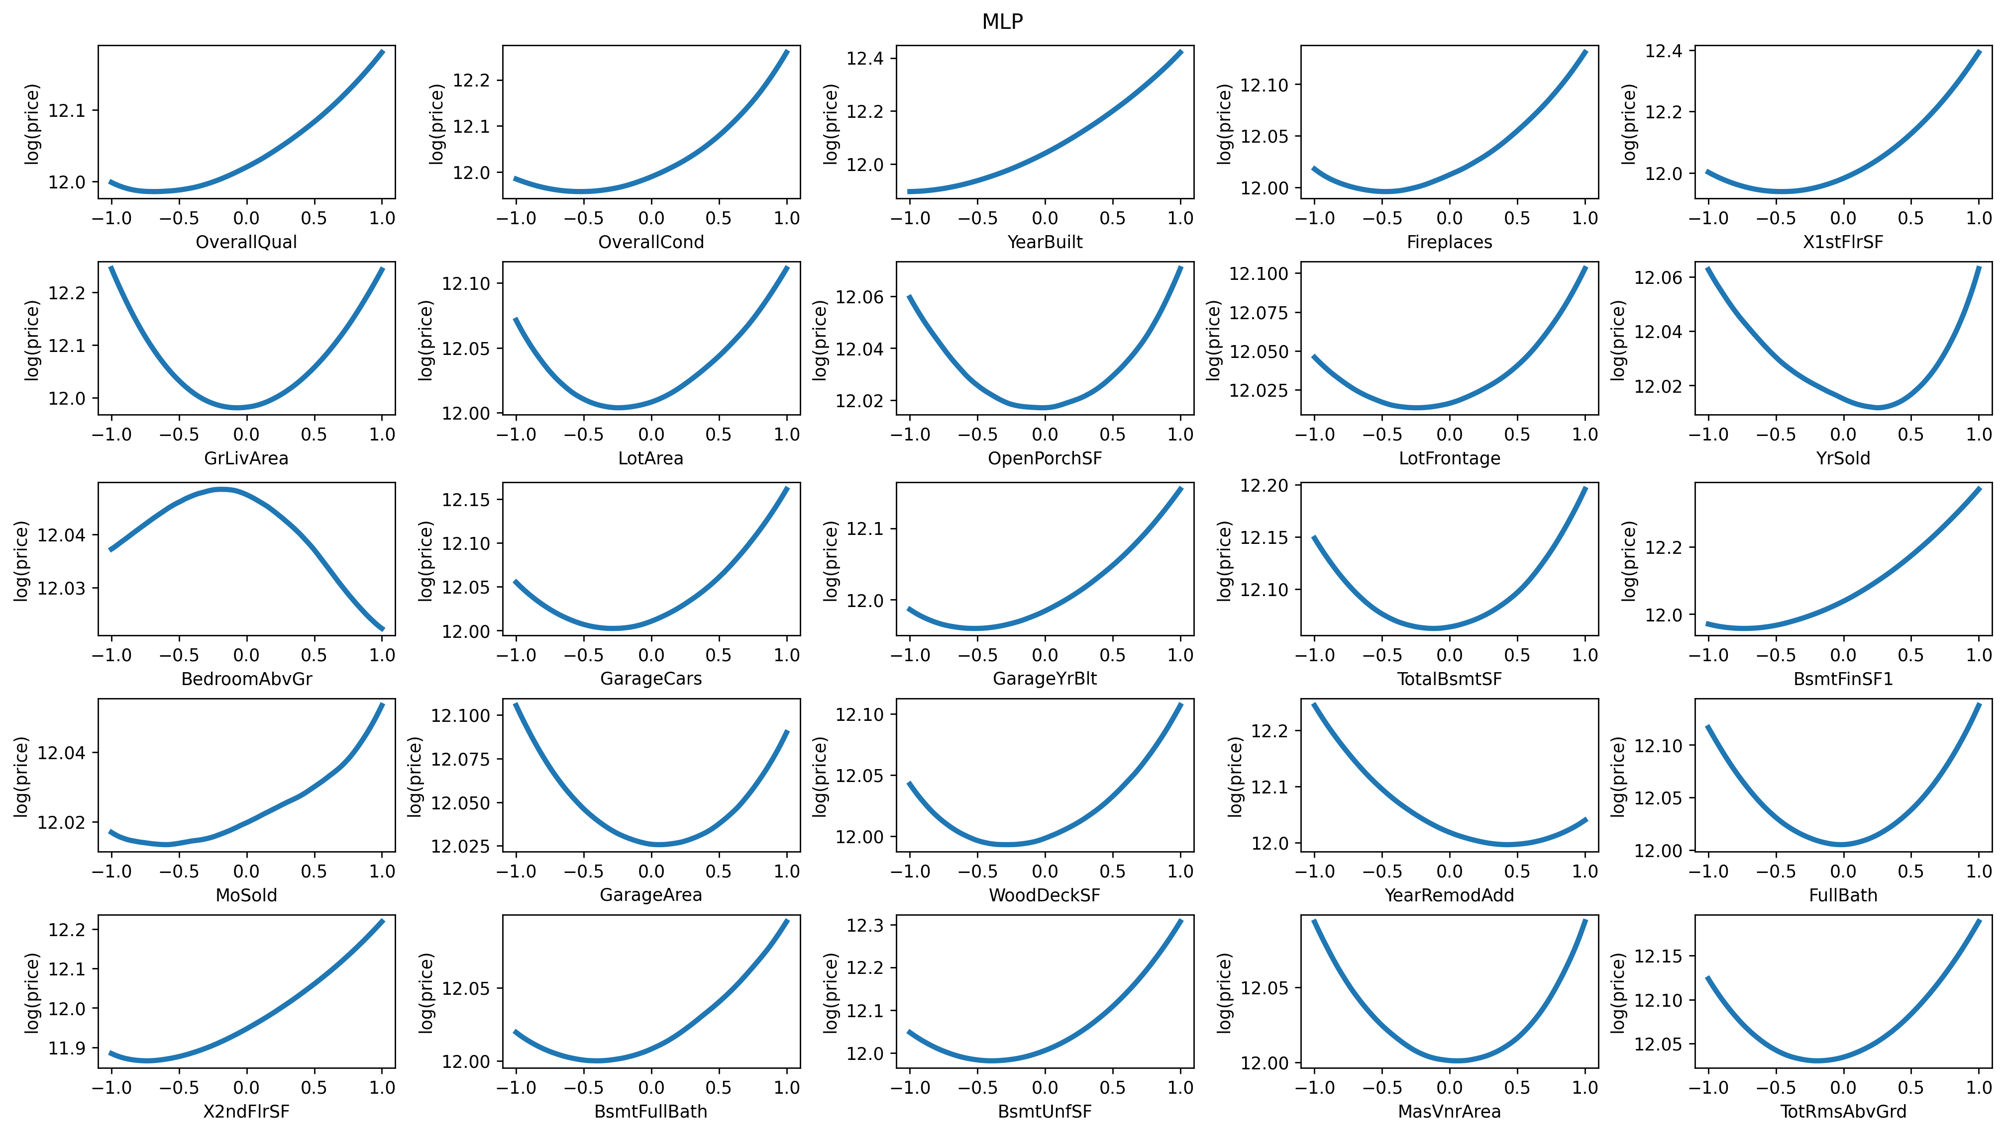

Slide 65
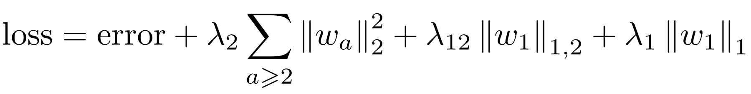
Sparse-input neural nets
Add a group lasso penalty to the first weight matrix
Ridge penalty for the other layers
group sparsity
sparsity
Sum of the L² norms
of the columns
Sparse-input neural networks for high-dimensional nonparametric regression (J. Feng and N. Simon, 2017)

Slide 66
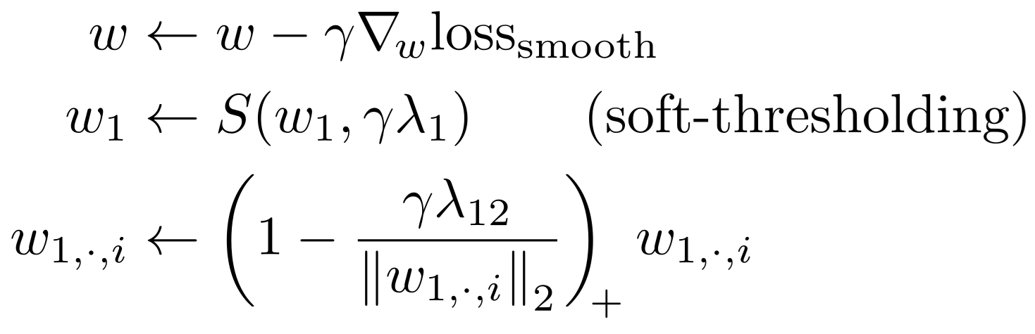
Sparse-input neural nets
Standard PyTorch optimizers do no always lead to sparse solutions: separate the smooth terms from the sparsifying ones, and use the proximal operator for the latter
Sparse-input neural networks for high-dimensional nonparametric regression (J. Feng and N. Simon, 2017)

Slide 67
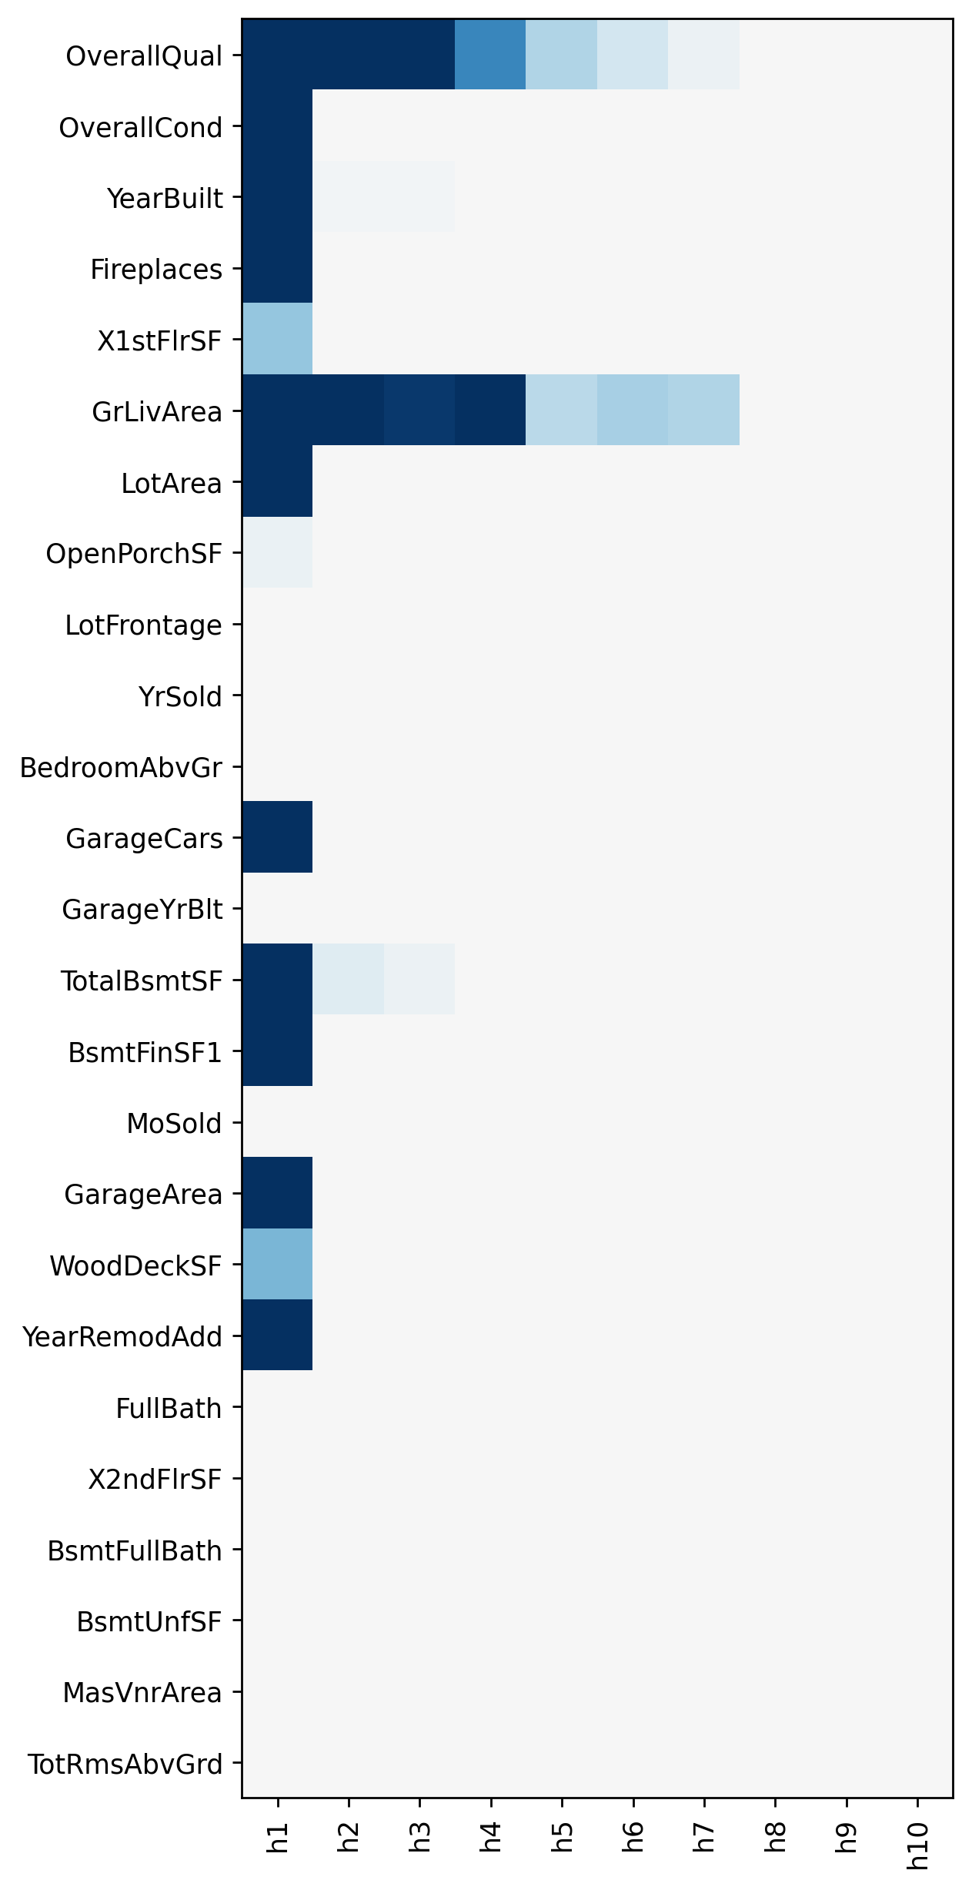
Sparse-input neural nets
error = loss_fn( y_hat, y_ )
penalty_12 = torch.linalg.vector_norm( model.fc1.weight, ord=2, dim=0 ).sum()
penalty_1 = torch.linalg.vector_norm( model.fc1.weight, ord=1, dim=0 ).sum()
penalty_2 = (
torch.linalg.vector_norm( model.fc2.weight, ord=2, dim=None ) ** 2 +
torch.linalg.vector_norm( model.fc3.weight, ord=2, dim=None ) ** 2
)
loss_smooth = error + lambda_2 * penalty_2
loss_smooth.backward()
optimizer.step()
with torch.no_grad():
soft_threshold_( model.fc1.weight, lr * lambda_1 * (1-alpha) )
for i in range( model.fc1.weight.shape[1] ):
w = model.fc1.weight[:,i]
n = torch.linalg.vector_norm(w, ord=2)
w.copy_( F.relu( 1 - lr * lambda_1 * alpha / n ) * w )
Sparse-input neural networks for high-dimensional nonparametric regression (J. Feng and N. Simon, 2017)

Slide 68
GAMI-Net
GAM, implemented as a neural net, with sparsity penalty, and interactions.
x₁
MLP
x₂
MLP
X
+
ŷ
⋮
⋮
xₖ
MLP
GAMI-Net: an explainable neural network based on GAMs with structured interactions (Z. Yang et al., 2020)

Slide 69
GAMI-Net
First-order effects
x₁
MLP
x₂
MLP
X
+
ŷ
⋮
⋮
xₖ
MLP
y
-
residual
GAMI-Net: an explainable neural network based on GAMs with structured interactions (Z. Yang et al., 2020)

Slide 70
GAMI-Net
Interaction selection
X
xᵢ,xⱼ
MLP
̂r
residual
loss
GAMI-Net: an explainable neural network based on GAMs with structured interactions (Z. Yang et al., 2020)

Slide 71
GAMI-Net
Interactions
xᵢ₁,xⱼ₁
MLP
xᵢ₂,xⱼ₂
MLP
X
+
̂r
⋮
⋮
xᵢₖ,xⱼₖ
MLP
residual
loss
GAMI-Net: an explainable neural network based on GAMs with structured interactions (Z. Yang et al., 2020)

Slide 72
GAMI-Net
Fine-tuning
x₁
MLP
⋮
⋮
xₖ
MLP
X
+
ŷ
xᵢ₁,xⱼ₁
MLP
⋮
⋮
xᵢₖ,xⱼₖ
MLP
GAMI-Net: an explainable neural network based on GAMs with structured interactions (Z. Yang et al., 2020)

Slide 73
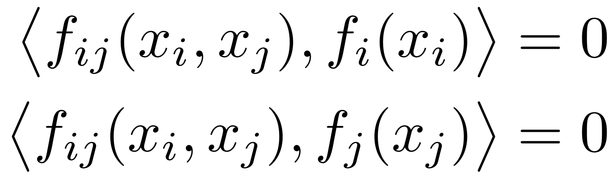
GAMI-Net: penalties
Sparsity penalty
Only include interactions if the corresponding main effects have been selected
Orthogonality between main effects and interactions

Slide 74
GAMI-Net
GAM, implemented as a neural net, with sparsity penalty, and interactions.
from piml.models import GAMINetRegressor
from piml import Experiment
exp = Experiment()
exp.data_loader( data = pd.concat( [ X, y ], axis=1 ) )
exp.data_prepare(target=y.name, task_type='regression', sample_weight=None)
exp.model_train(model=GAMINetRegressor(mono_increasing_list=X.columns), name="GAMI-Net")
model = exp.get_model("GAMI-Net")
GAMI-Net: an explainable neural network based on GAMs with structured interactions (Z. Yang et al., 2020)

Slide 75
GAMI-Net
Fit the main effects; set their means to zero; prune them (only keep those with the largest variance)
Fit interaction effects on the residuals, one pair of variables at a time, and only keep the pairs with the largest variance
Fit the interaction effects on the residuals, all at once, with a penalty to make them orthogonal to the main effects; prune them
Fine-tune the whole model (main and interaction effects) end-to-end
GAMI-Net: an explainable neural network based on GAMs with structured interactions (Z. Yang et al., 2020)

Slide 76
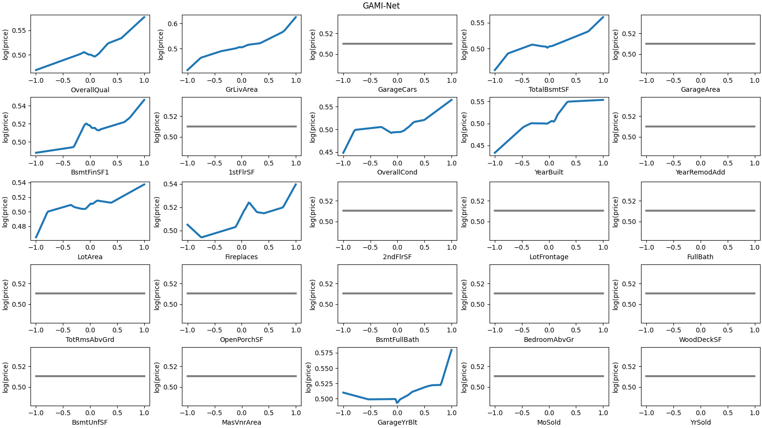

Slide 77
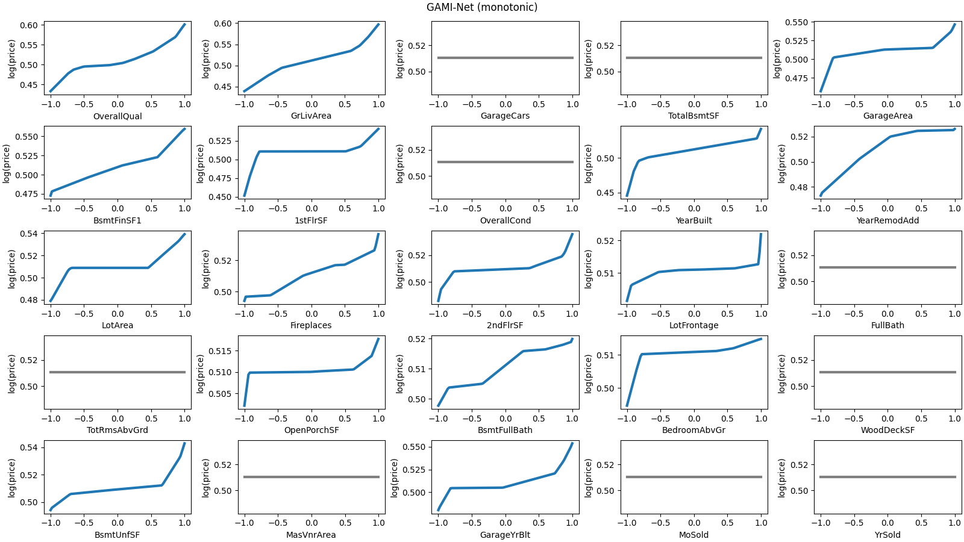

Slide 78


Monotonic MLP
MLP with non-negative weights and ReLU activations: monotonic but convex

Slide 79
Monotonic MLP
MLP with non-negative weights and ReLU activations: monotonic but convex
Use non-negative weights and 3 activation functions
Constrained monotonic neural networks, D. Runje and S.M. Shankaranarayana (2022)

Slide 80


Slide 81
Gradient penalty
Add a penalty when the gradient ∂ŷ/∂X is negative.
Notes:
This is not the gradient used to train the network, ∂loss/∂W
The gradient computations have to be added to the computation graph
This is a penalty, not a hard constraint
How to incorporate monotonicity in deep networks while preserving flexibility? A. Gupta et al. (2019)

Slide 82
Gradient penalty
W₁
W₂
W₃
X
ŷ
y
loss
How to incorporate monotonicity in deep networks while preserving flexibility? A. Gupta et al. (2019)

Slide 83



























Gradient penalty
W₁
W₂
W₃
X
ŷ
y
loss
How to incorporate monotonicity in deep networks while preserving flexibility? A. Gupta et al. (2019)

Slide 84





Gradient penalty
W₁
W₂
W₃
X
ŷ
y
loss
How to incorporate monotonicity in deep networks while preserving flexibility? A. Gupta et al. (2019)

Slide 85
Code: gradient penalty
# Gradient penalty
for epoch in range(10_000):
optimizer.zero_grad()
y_hat = model(X)
error = loss_fn( y_hat, y )
g = torch.autograd.grad(
outputs = y_hat.sum(),
inputs = X,
grad_outputs = torch.ones(y_hat.size()),
create_graph = True,
retain_graph = True,
)[0]
# Hinge loss, progressively increasing
penalty = torch.relu(-g+.001).mean() * epoch/100
loss = error + penalty
loss.backward()
optimizer.step()

Slide 86
Code: gradient penalty
# Gradient penalty
for epoch in range(10_000):
optimizer.zero_grad()
y_hat = model(X)
error = loss_fn( y_hat, y )
g = torch.autograd.grad(
outputs = y_hat.sum(),
inputs = X,
grad_outputs = torch.ones(y_hat.size()),
create_graph = True,
retain_graph = True,
)[0]
# Hinge loss, progressively increasing
penalty = torch.relu(-g+.001).mean() * epoch/100
loss = error + penalty
loss.backward()
optimizer.step()

Slide 87
Code: gradient penalty
# Gradient penalty
for epoch in range(10_000):
optimizer.zero_grad()
y_hat = model(X)
error = loss_fn( y_hat, y )
g = torch.autograd.grad(
outputs = y_hat.sum(),
inputs = X,
grad_outputs = torch.ones(y_hat.size()),
create_graph = True,
retain_graph = True,
)[0]
# Hinge loss, progressively increasing
penalty = torch.relu(-g+.001).mean() * epoch/100
loss = error + penalty
loss.backward()
optimizer.step()

Slide 88


Slide 89


Slide 90

MIP monotonicity proof
A neural network with linear layers and ReLU activations is a piecewise linear function: it can be used in a linear program.
Monotonicity can be formulated as the infeasibility of a linear program.
Certified monotonic neural networks, X. Liu et al. (2020)

Slide 91

MIP monotonicity proof
A neural network with linear layers and ReLU activations is a piecewise linear function: it can be used in a linear program.
Monotonicity can be formulated as the infeasibility of a linear program.
Certified monotonic neural networks, X. Liu et al. (2020)

Slide 92

MIP monotonicity proof
A neural network with linear layers and ReLU activations is a piecewise linear function: it can be used in a linear program.
Monotonicity can be formulated as the infeasibility of a linear program.
Certified monotonic neural networks, X. Liu et al. (2020)

Slide 93
Adversarial examples
Use such counter-examples during training:
Every other iteration, for each sample x, find the worst counter-examples in each direction, xₗ, xᵤ, and replace y with the average of f(xₗ) and f(xᵤ)
Counterexample-guided learning of monotonic neural networks, A. Sivaraman et al. (2020)

Slide 94

Varying coefficient models
Locally linear model: where θ varies very slowly.
Towards Robust Interpretability with Self-Explaining Neural Networks (D. Alvarez-Melis and T.S. Jaakkola, 2018)

Slide 95
Varying coefficient models
Locally linear model: where θ varies very slowly.
Often, θ only depends on a small number (one) of the xᵢ’s.
Towards Robust Interpretability with Self-Explaining Neural Networks (D. Alvarez-Melis and T.S. Jaakkola, 2018)

Slide 96

Varying coefficient models
MLP
θ(x)
X
×
̂ŷ
Towards Robust Interpretability with Self-Explaining Neural Networks (D. Alvarez-Melis and T.S. Jaakkola, 2018)

Slide 97

class Net(nn.Module): # VCM
def __init__(self, n_inputs, k):
super(Net, self).__init__()
self.fc1 = nn.Linear( n_inputs, k )
self.fc2 = nn.Linear( k, n_inputs )
self.intercept = nn.Parameter( torch.tensor(0.) )
def forward(self, x):
h = F.relu( self.fc1(x) )
beta = self.fc2(h)
y = self.intercept + torch.sum( beta * x, dim=1, keepdim=True )
return beta, y
model = Net( X_.shape[1], 20 )
with torch.no_grad():
model.intercept.copy_( torch.tensor( y.mean() ) )
optimizer = optim.AdamW( model.parameters() )
loss_fn = nn.MSELoss(reduction='mean')
for epoch in tqdm(range(10_000)):
optimizer.zero_grad()
beta, y_hat = model(X_)
error = loss_fn( y_hat, y_ )
penalty = torch.tensor(0)
g = torch.autograd.grad(
outputs = y_hat,
inputs = X_,
grad_outputs = torch.ones(y_hat.size()),
create_graph = True,
retain_graph = True,
)[0]
penalty = torch.sum( ( g - beta ) ** 2 ) / X_.shape[0]
penalty_pos = F.relu( -beta ).sum()
loss = error + 10 * penalty + 1e-2 * penalty_pos
loss.backward()
optimizer.step()

Slide 98

Self-explaining neural nets
Locally linear model: where θ varies very slowly and h comes from an auto-encoder.
Towards Robust Interpretability with Self-Explaining Neural Networks (D. Alvarez-Melis and T.S. Jaakkola, 2018)

Slide 99

Self-explaining neural nets
MLP
θ(x)
×
̂ŷ
X
MLP
h(x)
MLP
̂x
Towards Robust Interpretability with Self-Explaining Neural Networks (D. Alvarez-Melis and T.S. Jaakkola, 2018)

Slide 100
class Net(nn.Module):
def __init__(self, n_inputs, theta_k, h_k1, h_k2):
super(Net, self).__init__()
self.theta_fc1 = nn.Linear( n_inputs, theta_k )
self.theta_fc2 = nn.Linear( theta_k, h_k2 )
self.intercept = nn.Parameter( torch.tensor(0.) )
self.enc_fc1 = nn.Linear( n_inputs, h_k1 )
self.enc_fc2 = nn.Linear( h_k1, h_k2 )
self.dec_fc1 = nn.Linear( h_k2, h_k1 )
self.dec_fc2 = nn.Linear( h_k1, n_inputs )
def forward(self, x):
h = self.enc_fc2( F.relu( self.enc_fc1( x ) ) )
xhat = self.dec_fc2( F.relu( self.dec_fc1( h ) ) )
theta = self.theta_fc2( F.relu( self.theta_fc1(x) ) )
yhat = self.intercept + torch.sum( theta * h, dim=1, keepdim=True )
return h, xhat, theta, yhat
h, x_hat, beta, y_hat = model(X_)
error = loss_fn( y_hat, y_ )
reconstruction = loss_fn( x_hat, X_ )
g = torch.autograd.grad(
outputs = y_hat,
inputs = X_,
grad_outputs = torch.ones(y_hat.size()),
create_graph = True,
retain_graph = True,
)[0]
Js = [ # Isn't there an easier way to do that?
torch.autograd.grad(
outputs = h[:,i],
inputs = X_,
grad_outputs = torch.ones(h[:,i].size()),
retain_graph = True,
create_graph = True,
)[0]
for i in range(h.shape[1])
]
Js = [ J.view( J.shape[0], J.shape[1], 1 ) for J in Js ]
J = torch.concat(Js,2)
penalty = torch.sum( ( g - torch.einsum('ik,ijk->ij', beta, J) ) ** 2 ) / X_.shape[0] loss = error + reconstruction + 10 * penalty

Slide 101

Mixture of experts
VCM
GAM
Granger-causal attentive mixtures of experts (P. Schwab et al., 2018)

Slide 102

Mixture of experts
Granger-causal attentive mixtures of experts (P. Schwab et al., 2018)

Slide 103



Slide 104
Conclusion

Slide 105
Conclusion
Add sign constraints or monotonicity penalties to your models
Add sparsity penalties to your models
Prefer additive models (GAM, GA²M): while sparse and interpretable, they allow for nonlinearities and interactions

Slide 106
Test MSE
Model | MSE
Constant | 0.150
OLS | 0.022
Lasso | 0.023
Constrained regression | 0.026
Decision tree | 0.057
Monotonic DT | 0.057
XGBoost | 0.021
LightGBM | 0.020
CatBoost | 0.019
XGBoost (monotonic) | 0.024
LightGBM (monotonic) | 0.020
CatBoost (monotonic) | 0.033
GAM | 0.019
Model | MSE
GAM (monotonic) | 0.017
Neural Net | 0.058
AIM | 0.040
Symbolic regression | 0.033
GAM Boosting | 0.025
NN with positive weights | 0.028
NN with gradient penalty | 0.022
Sparse-input NN | 0.032
GAMI-Net | 0.020
GAMI-Net (monotonic) | 0.020
Varying coefficient model | 0.023
Self-explaining neural net | 0.021
Mixture of experts | 0.018

Slide 107
References
Interpretable Machine Learning, C. Molnar (2020)
Why should I trust you? Explaining the predictions of any classifier, M.T. Ribeiro et al. (2016)
Designing inherently interpretable machine learning models, A. Sudjianto and A. Zhang (2021)
Statistical Learning with Sparsity, T. Hastie et al. (2015)
Supersparse linear integer model for interpretable classification, B. Ustun et al. (2013)
An optimization approach to learning falling rule lists, C. Chen and C. Rudin (2017)
Generalized additive models (S.N. Wood, 2017)
Model-based boosting in R: a hands-on tutorial using the R package mboost (B. Hofner et al., 2014)
Interpretable machine learning for science with PySR and SymbolicRegression.jl, M. Cranmer (2023)
Sparse-input neural networks for high-dimensional nonparametric regression (J. Feng and N. Simon, 2017)
GAMI-Net: an explainable neural network based on GAMs with structured interactions (Z. Yang et al., 2020)
Constrained monotonic neural networks, D. Runje and S.M. Shankaranarayana (2022)
How to incorporate monotonicity in deep networks while preserving flexibility? A. Gupta et al. (2019)
Certified monotonic neural networks, X. Liu et al. (2020)
Counterexample-guided learning of monotonic neural networks, A. Sivaraman et al. (2020)
Towards Robust Interpretability with Self-Explaining Neural Networks (D. Alvarez-Melis and T.S. Jaakkola, 2018)
Interpretable and explainable machine learning: a methods-centric overview with concrete examples (R. Marcinkevičs and J.E. Vogt, 2023)
Granger-causal attentive mixtures of experts (P. Schwab et al., 2018)

Slide 108
Extra Slides

Slide 109
XAI

Slide 110


Shapley Values
Decomposition of the performance of a model into a sum of contributions of each input variable, obtained by fitting the model on all subsets of variables.

Slide 111
Global Surrogate Models
Simpler, interpretable model (e.g., linear regression or shallow regression tree), trained to reproduce the output of a more complicated model.
Interpretable Machine Learning, C. Molnar (2020)

Slide 112
Local Surrogate Models
Simpler, interpretable model (e.g., linear regression or shallow regression tree), trained to reproduce the output of a more complicated model, but only in the vicinity of a given observation.
“For observations similar to this one, the model works as follows: ...”
Why should I trust you? Explaining the predictions of any classifier, M.T. Ribeiro et al. (2016)

Slide 113
Counterfactuals
For a given observation, which input variable should we change to change the ouput?

Slide 114
Saliency maps, etc.
For a given observation, decompose the output into a sum of contributions of each input variable.
Evaluating the visualization of what a deep neural network has learned, W. Samek et al. (2015)

Slide 115
SLIM
We want many of the βᵢ to be 0
0-1 loss
Small ℓ¹ penalty
Binary output: ±1
Binary inputs: ±1
Supersparse linear integer model for interpretable classification, B. Ustun et al. (2013)

Slide 116

Big-M constraint: ℓ⁰ norm
Supersparse linear integer model for interpretable classification, B. Ustun et al. (2013)

Slide 117

Big-M constraint: 0-1 loss
Supersparse linear integer model for interpretable classification, B. Ustun et al. (2013)

Slide 118

SLIM
Supersparse linear integer model for interpretable classification, B. Ustun et al. (2013)

Slide 119
# Untested -- do not use
B = 5 # Maximum value of the coefficients
C0 = .001 # L⁰ penalty -- you will need to fine-tune this
C1 = C0/100 # L¹ penalty -- we want the L¹ penalty to be smaller than the L⁰ penalty: it is only there to avoid ties
gamma = .5
assert np.all( np.isin( Xb, [-1,+1] ) ), "Data should be binary, ±1"
assert np.all( np.isin( yb, [-1,+1] ) ), "Data should be binary, ±1"
n,k = Xb.shape
beta = cp.Variable(k, integer=True)
z = cp.Variable(k, boolean=True)
L = cp.Variable(n, boolean=True)
loss = cp.mean(L)
penalty0 = cp.sum(z)
penalty1 = cp.norm1(beta)
objective = loss + C0 * penalty0 + C1 * penalty1
constraints = [
-B * z <= beta, beta <= B * z,
gamma + cp.multiply( - yb , Xb @ beta ) <= (gamma+k*B) * L
]
prob = cp.Problem( cp.Minimize( objective ), constraints )
result = prob.solve(
solver = cp.MOSEK,
mosek_params = {
'MSK_DPAR_OPTIMIZER_MAX_TIME': 5.0, # In seconds; you should be more patient
},
)
print( f"Status: {prob.status}" )
print( f"Time: {int( prob.solver_stats.solve_time )} seconds" )
print( f"loss = {cp.sum(L).value.astype(int)} / {len(yb)} = {loss.value:.3f}" )
print( f"L0 penalty = {np.sum(z.value).astype(int)}" )
print( f"objective = {objective.value:.3f}" )
print( f"beta = {beta.value.astype(int)}" )

Slide 120
Gradient boosting libraries
If in doubt, prefer catboost:
XGBoost: uses stumps
Lightgbm: faster, more scalable
Catboost: better handling of categorical values, less prone to overfitting

Slide 121

Additive Index Model (AIM)

Slide 122

Additive Index Model (AIM)

Slide 123

Additive Index Model (AIM)

Slide 124

Additive Index Model (AIM)

Slide 125

Proximal operators
A sparse-group lasso (N. Simon et al., 2013)

Slide 126

Proximal gradient descent
A sparse-group lasso (N. Simon et al., 2013)

Slide 127



Varying coefficient models
I tried to add a penalty on
or
or

Slide 128
Regularization paths

Slide 129


Slide 130


Slide 131


Slide 132


Slide 133


Slide 134


Slide 135


Slide 136


Slide 137


Slide 138


Slide 139


Slide 140


Slide 141


Slide 142
Unused Slides

Slide 143
Supersparse linear integer model for interpretable classification, B. Ustun et al. (2013)

Slide 144
Definitions
No definition/measure of “interpretability” or “explainability”
Some authors use those terms interchangeably
Interpretable model = interpretable by construction
Explanation methods = post hoc, works on trained, blackbox models

Slide 145
Interpretability
Additivity
Sparsity
Linearity
Smoothness
Monotonicity
Visualizability
Projection
Segmentation

Slide 146
Additive Models
GAM
AIM
GA2M (GAM with interactions)
GAM Boosting

Slide 147
Before: Interpretable AI
(Monotonic) falling rule lists, decision trees
Sparse linear models, SLIM, sparse input neural net, fused lasso, graph sparsity
GAM, GA2M, neural GAM, GAM boosting
Varying coefficient models, self-explaining neural nets
Attentive mixture of experts
Sign and monotonicity constraints
Symbolic regression
Disentangled representations

Slide 148
Before: Interpretable AI
Prior, inductive bias:
Decision trees, rule lists
Linear regression, (graph) sparsity
GAM Boosting
Linear regression, sign constraints
Neural networks

Slide 149
Zoo of interpretable models
Rule-based
Sparse
Additive

Slide 150
Code
# ElasticNet (linear regression with L¹ and L² penalties)
model = sklearn.linear_model.ElasticNet( alpha = alpha )
model.fit( X, y )
yhat = model.predict(X)

Slide 151
Code
error = loss_fn( y_hat, y_ )
penalty_12 = torch.linalg.vector_norm( model.fc1.weight, ord=2, dim=0 ).sum()
penalty_1 = torch.linalg.vector_norm( model.fc1.weight, ord=1, dim=0 ).sum()
penalty_2 = (
torch.linalg.vector_norm( model.fc2.weight, ord=2, dim=None ) ** 2 +
torch.linalg.vector_norm( model.fc3.weight, ord=2, dim=None ) ** 2
)
loss_smooth = error + lambda_2 * penalty_2
loss_smooth.backward()
optimizer.step()
soft_threshold_( model.fc1.weight, lr * lambda_1 * (1-alpha) )
with torch.no_grad():
for i in range( model.fc1.weight.shape[1] ):
w = model.fc1.weight[:,i]
n = torch.linalg.vector_norm(w, ord=2)
w.copy_( F.relu( 1 - lr * lambda_1 * alpha / n ) * w )

Slide 152
Code
class Net(nn.Module):
def __init__(self, n_input, k1, k2):
super(Net, self).__init__()
self.fc1 = nn.Linear(n_input, k1)
self.fc2 = nn.Linear(k1, k2)
self.fc3 = nn.Linear(k2, 1)
def forward(self, x):
h1 = F.relu( self.fc1(x) )
h2 = F.relu( self.fc2(h1) )
return self.fc3(h2)
model = Net( X.shape[1], 200, 200 )
optimizer = optim.Adam( model.parameters() )
loss_fn = nn.MSELoss(reduction='mean')
for epoch in tqdm(range(10_000)):
optimizer.zero_grad()
y_hat = model(X_)
loss = loss_fn( y_hat, y_ )
loss.backward()
optimizer.step()

Slide 153


Slide 154

Gradient boosting

Slide 155


Slide 156

Shapley Values
Decomposition of the performance of a model into a sum of contributions of each input variable, obtained by fitting the model on all subsets of variables.

Slide 157

SLIM
Combine binary inputs with simple integer coefficients
Supersparse linear integer model for interpretable classification, B. Ustun et al. (2013)

Slide 158

Gradient boosting

Slide 159
MLP
X
linear
class Net(nn.Module):
def __init__(self, n_input, k1, k2):
super(Net, self).__init__()
self.fc1 = nn.Linear(n_input, k1)
self.fc2 = nn.Linear(k1, k2)
self.fc3 = nn.Linear(k2, 1)
def forward(self, x):
h1 = F.relu( self.fc1(x) )
h2 = F.relu( self.fc2(h1) )
return self.fc3(h2)
model = Net( X.shape[1], 200, 200 )
optimizer = optim.Adam( model.parameters() )
loss_fn = nn.MSELoss(reduction='mean')
for epoch in tqdm(range(10_000)):
optimizer.zero_grad()
y_hat = model(X_)
loss = loss_fn( y_hat, y_ )
loss.backward()
optimizer.step()
ReLU
linear
ReLU
linear
y

Slide 160

MIP monotonicity proof
A neural network with linear layers and ReLU activations is a piecewise linear function: it can be used in a linear program.
Monotonicity can be formulated as the infeasibility of a linear program.
Certified monotonic neural networks, X. Liu et al. (2020)

Slide 161
Interpretable models
Some have robust, maintained implementations, but most only have an unmaintained proof-of-concept implementation
Some are easy to implement from scratch
Some are not

Slide 162


Slide 163



Variable Coefficient Models
Reconstruction loss:
Prediction loss:
Penalty:

Slide 164
Self-explaining neural nets
Locally linear model: where θ varies very slowly and h comes from an auto-encoder.
MLP
θ(x)
×
̂ŷ
X
MLP
h(x)
MLP
̂x
Towards Robust Interpretability with Self-Explaining Neural Networks (D. Alvarez-Melis and T.S. Jaakkola, 2018)

Slide 165
Self-explaining neural nets
MLP
θ(x)
×
̂ŷ
X
MLP
h(x)
MLP
̂x
Towards Robust Interpretability with Self-Explaining Neural Networks (D. Alvarez-Melis and T.S. Jaakkola, 2018)

Slide 166
Examples from the papers

Slide 167
Falling Rule Lists

Slide 173
SLIM

Slide 184
Self-explaining neural net

Slide 188
LRP

Slide 191
Symbolic Regression

